Slide 1
Daily physical activity is very important to help keep a healthy mind and body during this difficult time. Click on an image below to try a workout.
Healthy body = healthy mind
Click Present to begin!
Superhero Workouts - Get Kids Moving
Harry Potter & Star Wars Workouts - Get Kids Moving
Yoga - Cosmic Kids
by Danielle Wiggin
@Miss_Wiggin
Click for more!

Slide 2
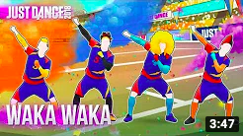
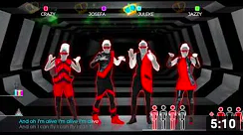
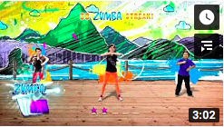
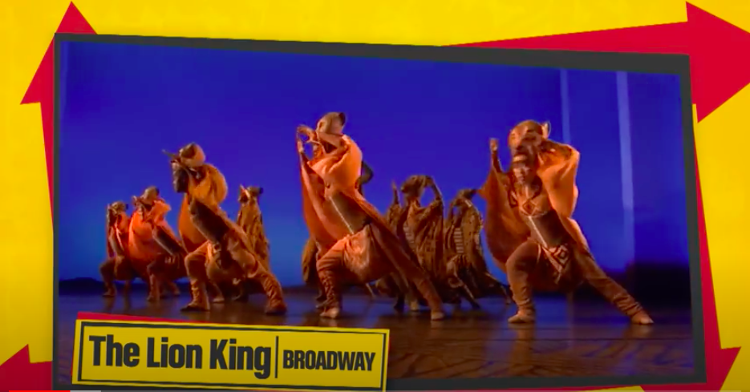
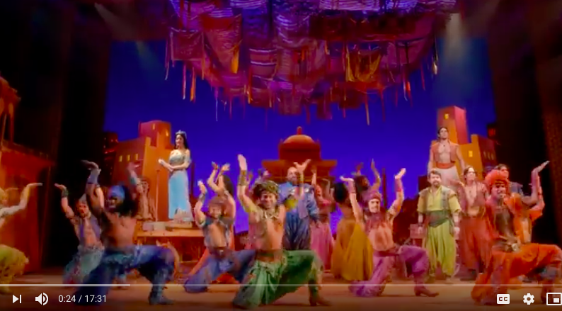
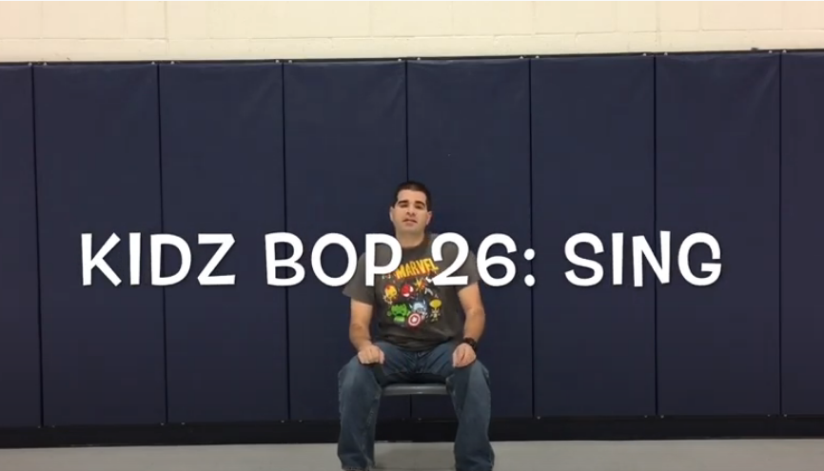
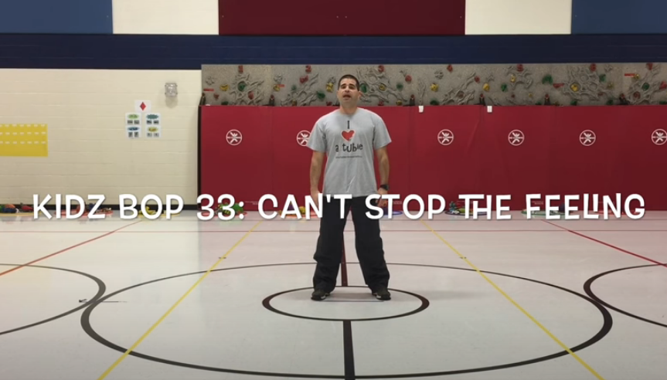
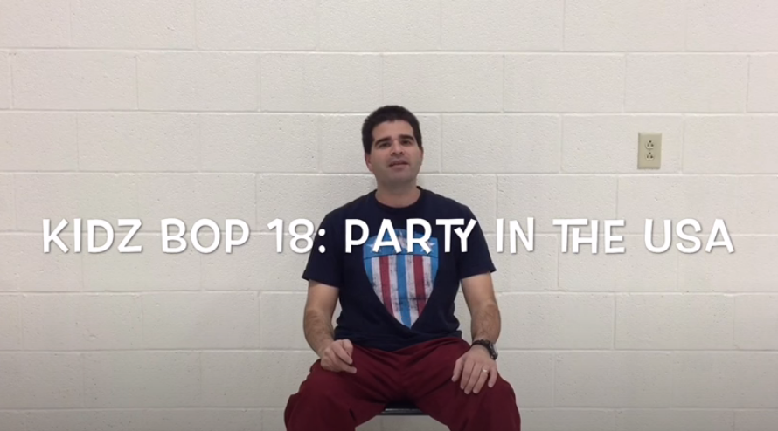
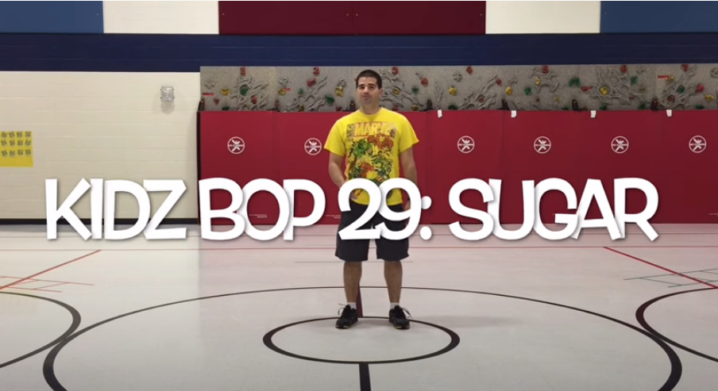
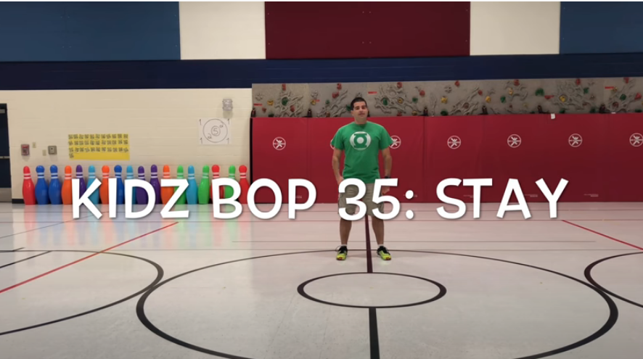
Daily physical activity is very important to help keep a healthy mind and body during this difficult time. Click on an image below to try a workout.
Healthy body = healthy mind
Just Dance
Dance - Various Channels
Aladdin
Let’s Dance - Ben Pirillo
by Danielle Wiggin
@Miss_Wiggin
Click for more!

Slide 3
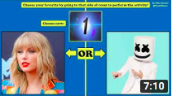
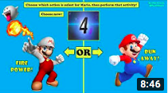
Daily physical activity is very important to help keep a healthy mind and body during this difficult time. Click on an image below to try a workout.
Healthy body = healthy mind
Fitness Fun - Mike Ginicola
PE at Home: Challenges - Mike Morris
Mindfulness and Feel Good Movement - Go Noodle
by Danielle Wiggin
@Miss_Wiggin
Click for more!

Slide 4
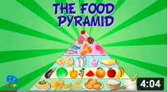
Daily physical activity is very important to help keep a healthy mind and body during this difficult time. Click on an image below to try a workout.
Healthy body = healthy mind
Our Bodies - Peekaboo Kidz
Our Bodies - SciShow Kids
Healthy Eating
by Danielle Wiggin
@Miss_Wiggin
Click here to Go Back to Beginning!

Slide 5
RETURN
TO

Slide 6
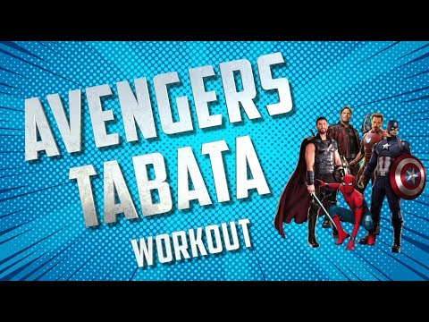
RETURN
TO

Slide 7
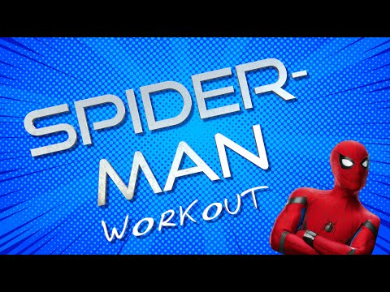
RETURN
TO

Slide 8
RETURN
TO

Slide 9
RETURN
TO

Slide 10
RETURN
TO

Slide 11
RETURN
TO

Slide 12
RETURN
TO

Slide 13
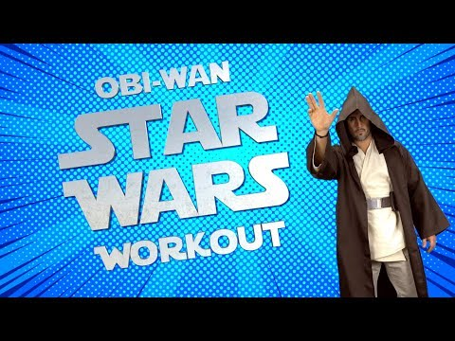
RETURN
TO

Slide 14
RETURN
TO

Slide 15
RETURN
TO

Slide 16
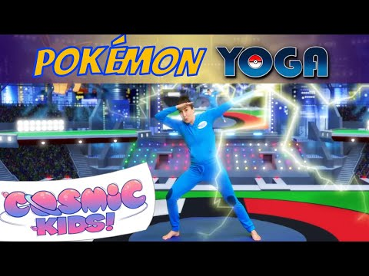
RETURN
TO

Slide 17
RETURN
TO

Slide 18
RETURN
TO

Slide 19
RETURN
TO

Slide 20
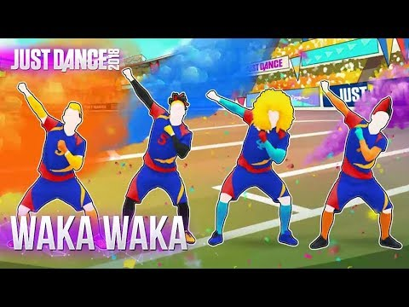
RETURN
TO

Slide 21
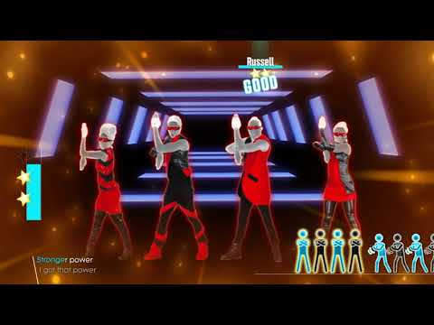
RETURN
TO

Slide 22
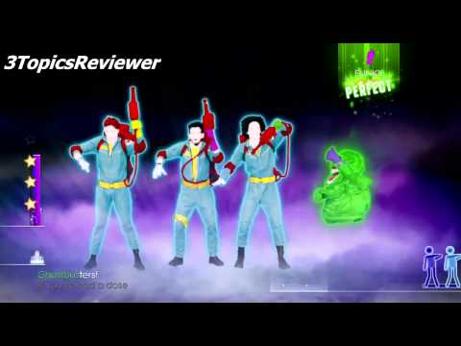
RETURN
TO

Slide 23
RETURN
TO

Slide 24
RETURN
TO

Slide 25
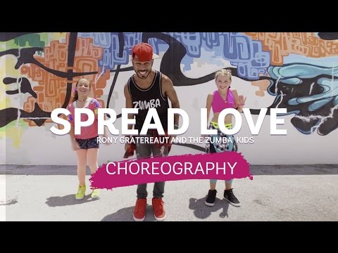
RETURN
TO

Slide 26
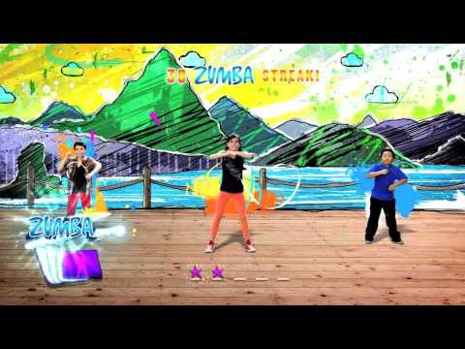
RETURN
TO

Slide 27
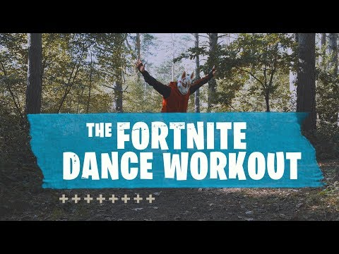
RETURN
TO

Slide 28
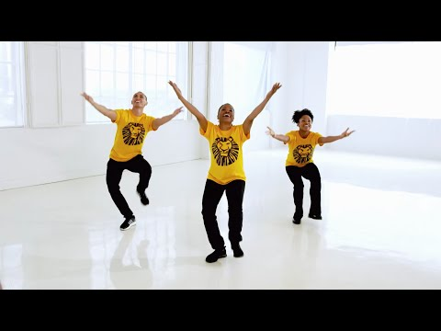
RETURN
TO

Slide 29
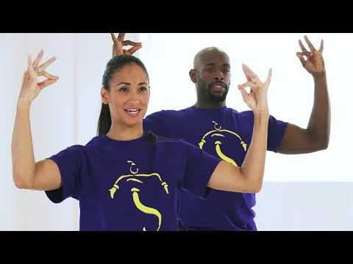
Aladdin
RETURN
TO

Slide 30
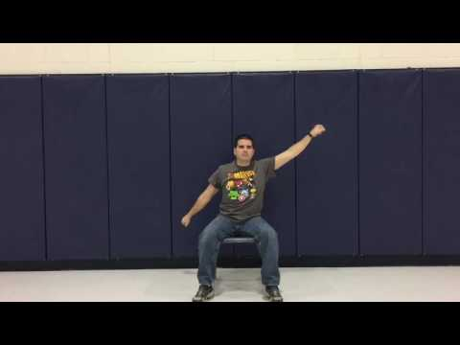
RETURN
TO

Slide 31
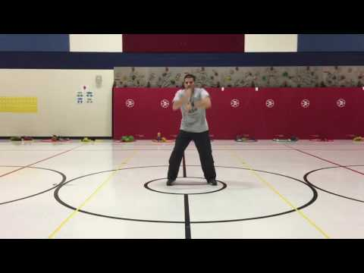
RETURN
TO

Slide 32
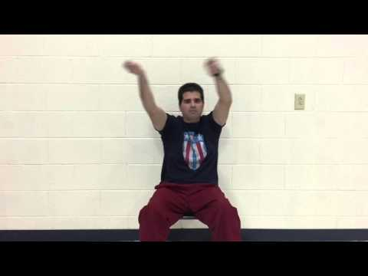
RETURN
TO

Slide 33
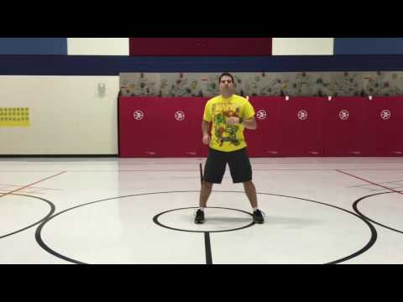
RETURN
TO

Slide 34
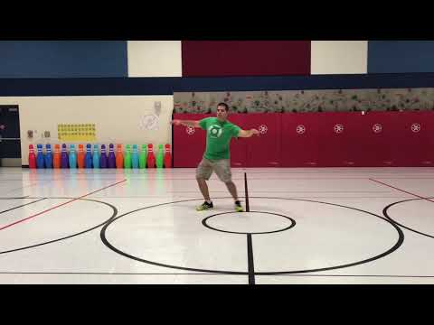
RETURN
TO

Slide 35
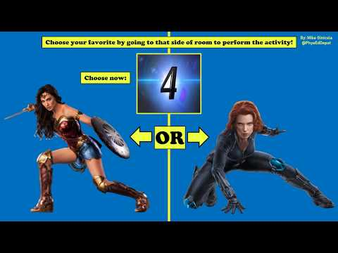
RETURN
TO

Slide 36
RETURN
TO

Slide 37
RETURN
TO

Slide 38
RETURN
TO

Slide 39
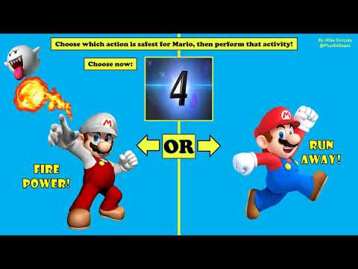
RETURN
TO

Slide 40
RETURN
TO

Slide 41
RETURN
TO

Slide 42
RETURN
TO

Slide 43
RETURN
TO

Slide 44
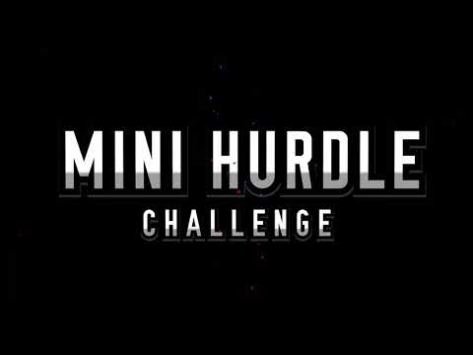
RETURN
TO

Slide 45
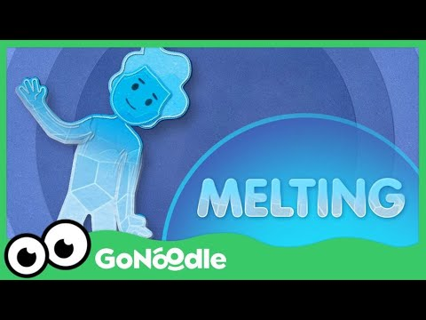
RETURN
TO

Slide 46
RETURN
TO

Slide 47
RETURN
TO

Slide 48
RETURN
TO

Slide 49
RETURN
TO

Slide 50
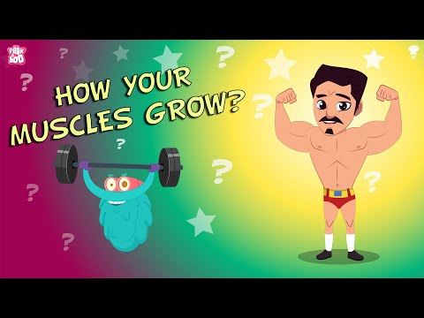
RETURN
TO

Slide 51
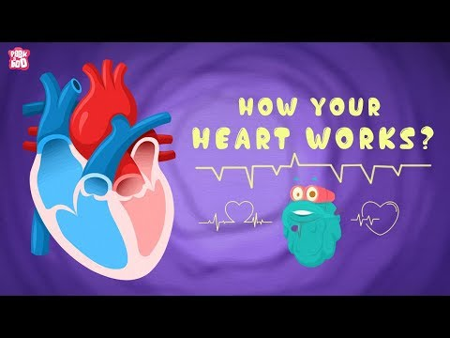
RETURN
TO

Slide 52
RETURN
TO

Slide 53
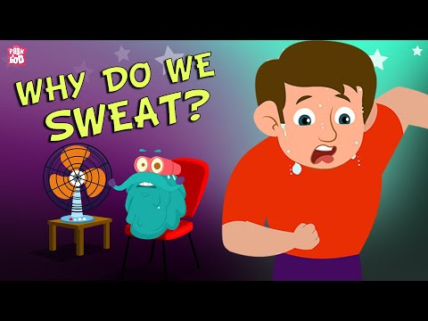
RETURN
TO

Slide 54
RETURN
TO

Slide 55
RETURN
TO

Slide 56
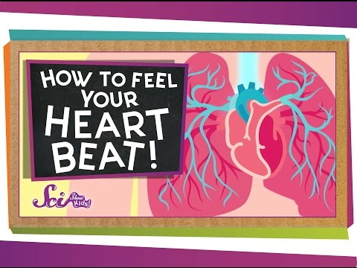
RETURN
TO

Slide 57
RETURN
TO

Slide 58
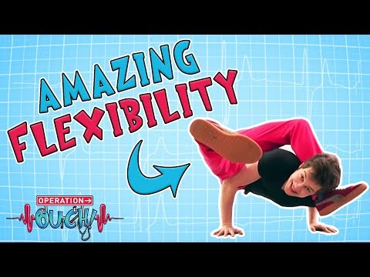
RETURN
TO

Slide 59
RETURN
TO

Slide 60
RETURN
TO

Slide 61
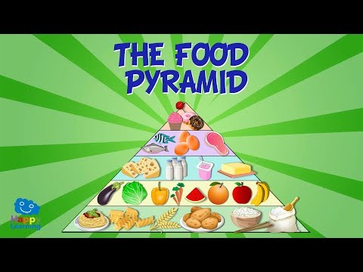
RETURN
TO

Slide 62
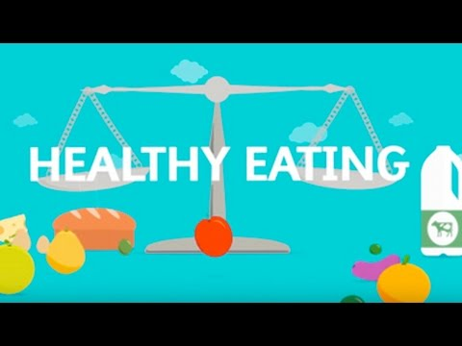
RETURN
TO

Slide 63
RETURN
TO

Slide 64
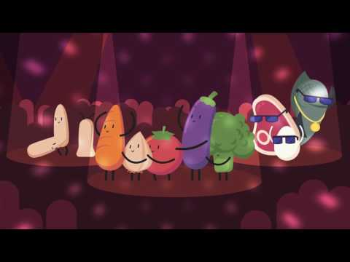
RETURN
TO

