Slide 1
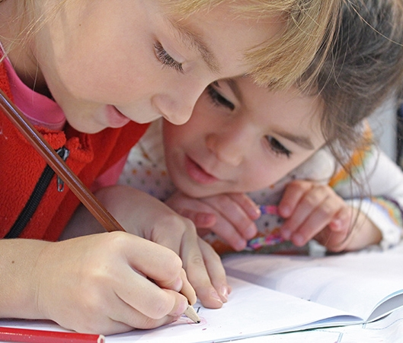
Virtual Classroom ASD-N
2021
2022
At home K to 2,
Literacy and Numeracy

Slide 2

Morning Routine

Slide 3
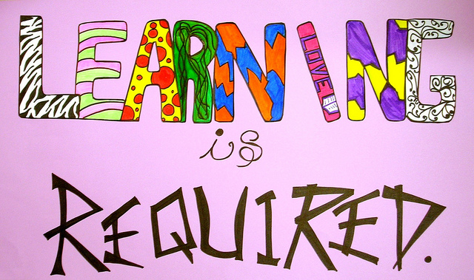
Numeracy and Literacy
At Home Learning
Recommendations for learning:
Please encourage 30 minutes of physical activity each day at home.
45minutes a day for literacy and numeracy in kindergarten and grade one.
60 minutes a day for literacy and numeracy in grade two.

Slide 4
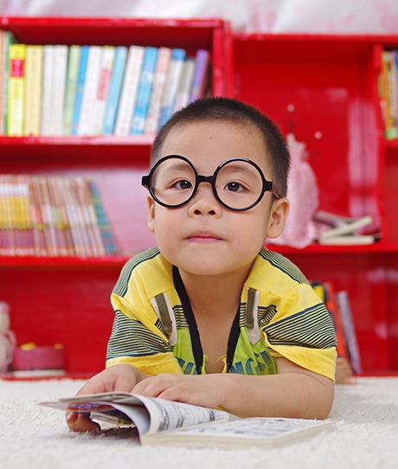
Morning Routine
Soft Start: Choose an activity
Kindness Activity
Walk outside
Help cooking Breakfast
Quiet Reading time
Coloring
Puzzle
Building

Slide 5
10Am
Phonics and word work Letter names Sight words Vocabulary Knowledge | Comprehension and Fluency Read to Self Read to Someone Else Listening to Someone Read
Writing Journal Drawing Art Recount stories Descriptive stories | Story online Squiggle Park K to 2 Tumble Books https://www.tumblebooklibrary.com/
Literacy

Slide 6
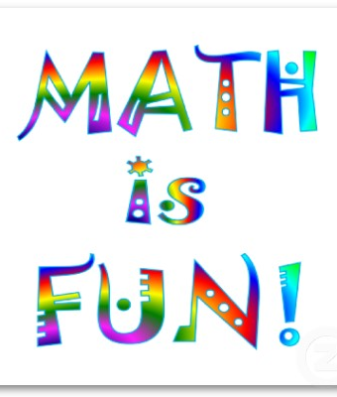
Mid Morning
Numeracy
Math Time
Dream Box
Games
Jack Hartman Videos – Lots of good counting and exercise.
Jack Hartmann Kids Music Channel - YouTube

Slide 7
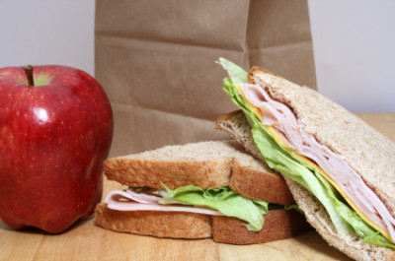
Lunch
Wash hands and have a healthy lunch!

Slide 8
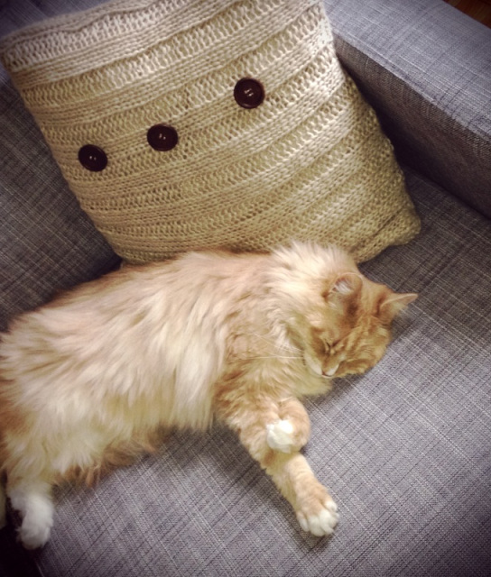
1pm to 1:30
Quiet Time
Choices
Reading
Puzzles
Nap
Drawing

Slide 9
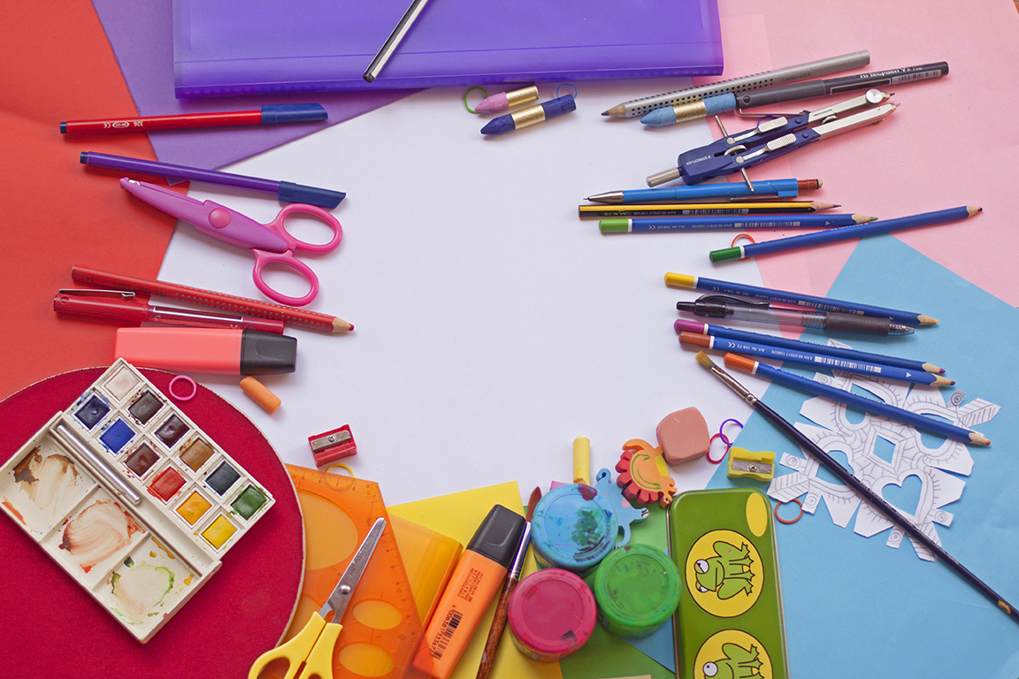
Afternoon
Creative Time
Lego
Drawing
Scrapbook
Seasonal Crafts
Baking

Slide 10
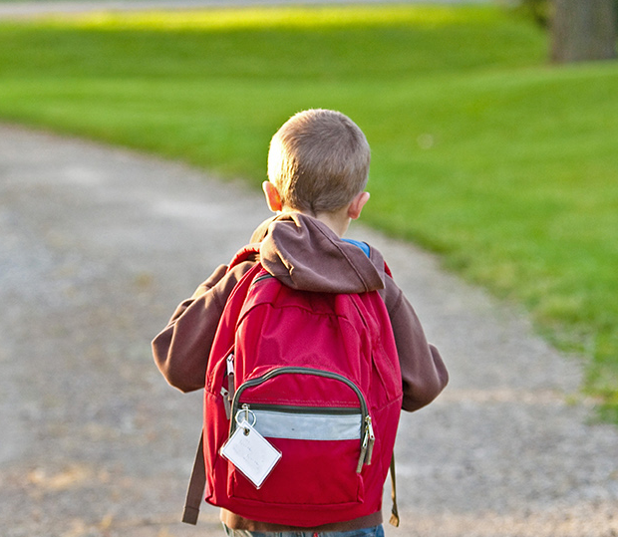
Late Afternoon
Fresh Air and Exercise
* When you are outside getting some exercise, you can practice counting forwards and backwards.

Slide 11
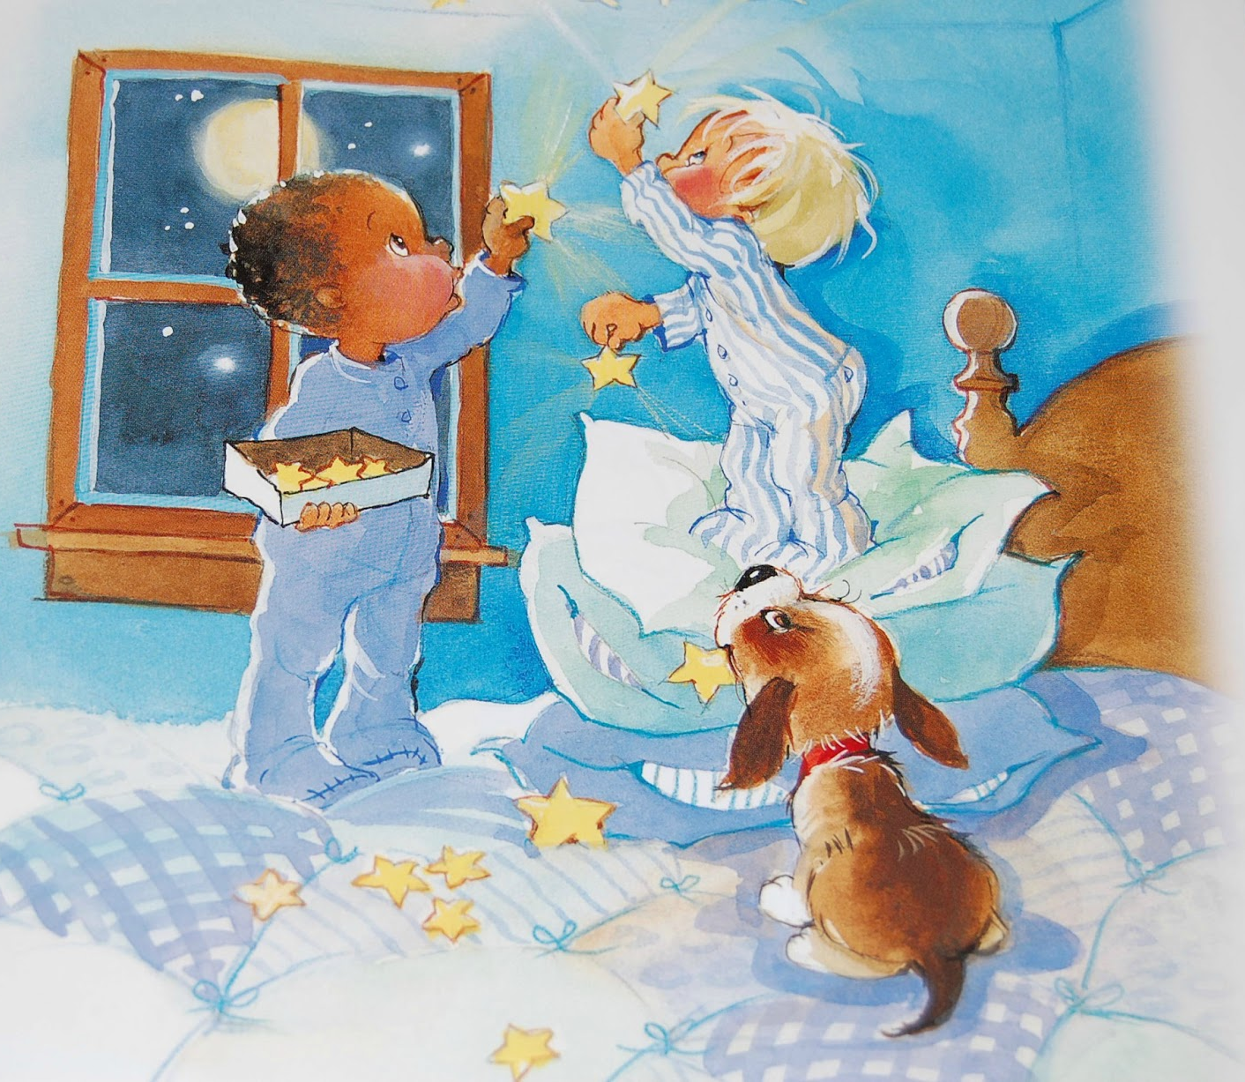
Bedtime
8PM

Slide 12


Slide 13
Choice board Activities

