Slide 1
Reading Log
Mrs. Murphy

Slide 2
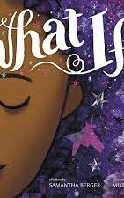
introduction
After finishing the book, "What If...", I felt grateful for my own creativity. The girl in the book demonstrated how she would use many of her different intelligences to express her creativity and I felt I could relate to her in many ways. The illustrations were beautiful and really helped to get the message across. The last picture in the book looked into the windows of many different people being creative. This page made me think of the many ways I love to create from cooking to cross-stich. I am grateful for my many gifts.
from book
my connection
from book
my connection
conclusion

