Slide 1
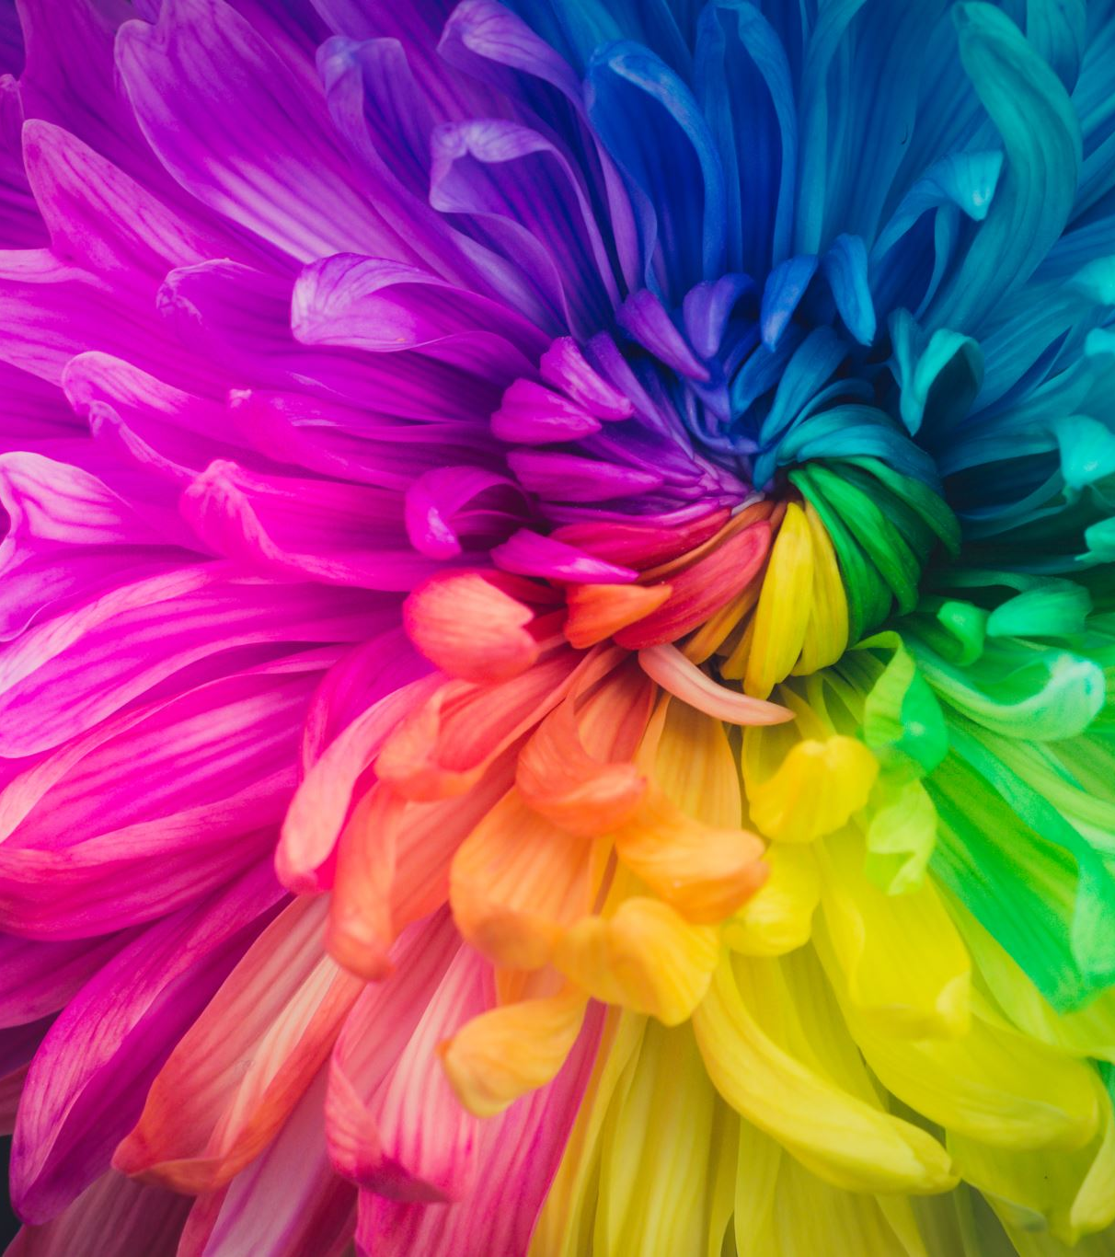
May
Morning
Warm-Ups

Slide 2
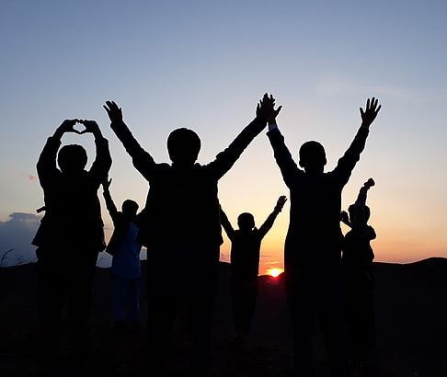
Friendship
Qualities
Colour the qualities that make a good friend.

Slide 3
Must be; Must enjoy;
fair watching t.v.
patient being outside
friendly walking
polite
Wanted:
A True Friend
Make two lists;
1. Must be ~ list 3-5 characteristics they must have.
2. Must enjoy~ list 3-5 things they need to like to do.
Do not draw in the blank space on the top!
Colour the title.

Slide 4
Complete the worksheet. Fill in the blanks with its or it's.

Slide 5
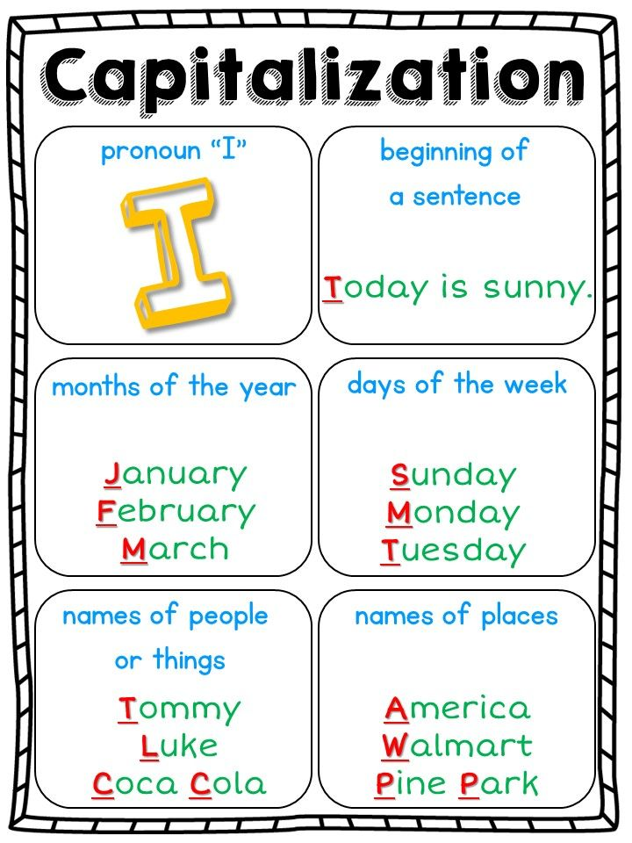
Complete the worksheet. Circle the words that should be capitalized. Write 3 sentences on the back of the sheet using some of the words that you circled.

Slide 6
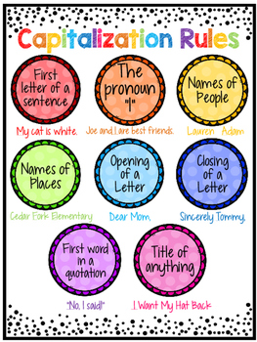
Use the capitalization rules to edit the letter. Don't forget to read the instruction for clues.

Slide 7
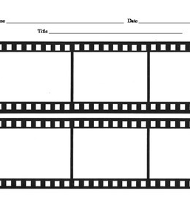
Complete the worksheet as instructed.
On the back of the sheet create a cartoon strip using stick figures.
Use at least 6 capital letters in your dialoge.

