Slide 1
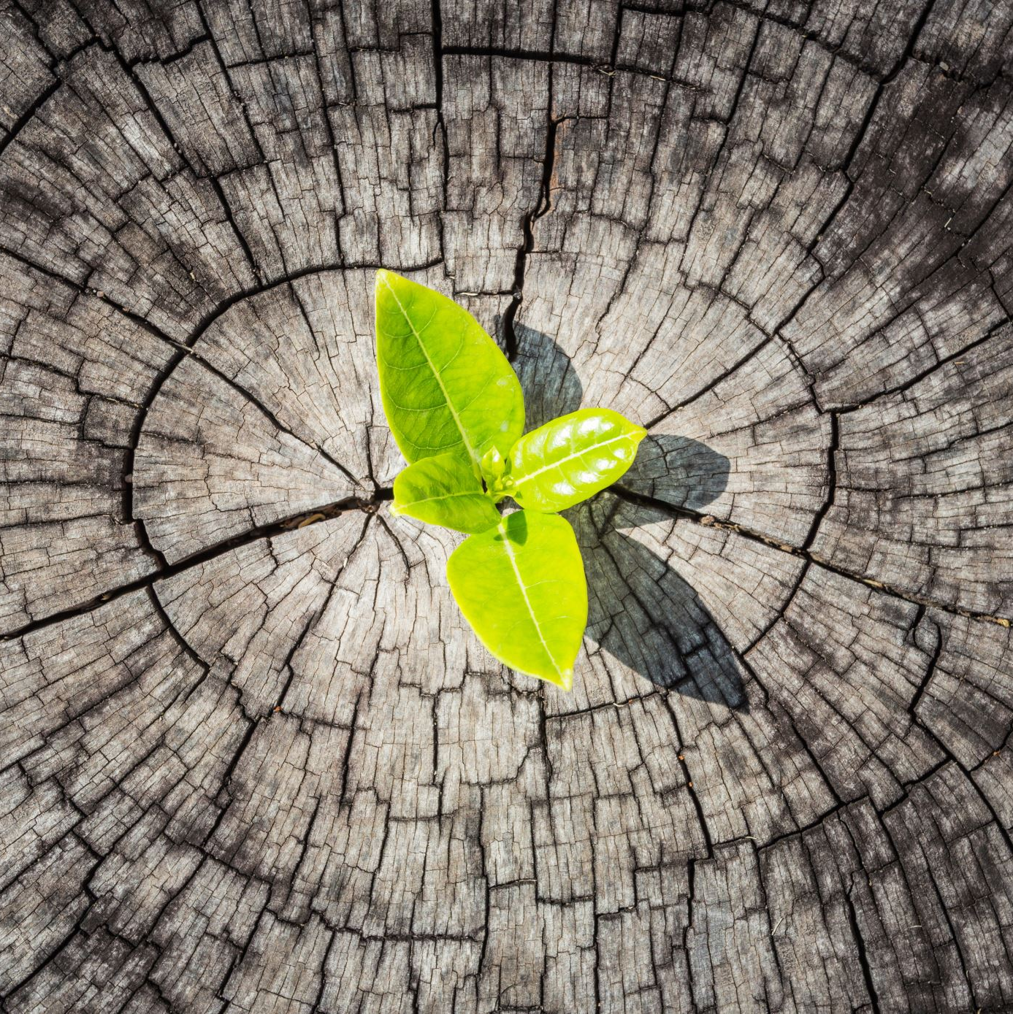
We Are The Land
Take Action for Reconciliation

Slide 2
https://www.youtube.com/watch?v=Ac4B0tQor2Q
Nature music
What images and feelings come to mind when you hear the word land?
What do you think of when you hear the word land?
Create a cover page for "We Are The Land" that shows what "land" means to you.

Slide 3
Tribal Nations
Iroquois
Métis
Heilisuk
Anishinaabe
Cree
Salish Cree
Nehiyaw Cree
Lubicon Cree
Tsimshian
Sioux
Haisla
Dene
Gwich'in
Omamiwinini
Algonquin
Wendat
Mohawk
Kanien'kéha:ka
Mi'kmaq
Gitga'at
Stoney
Sahtuot'jne
Blackfoot
Wikwemikong
Secwepemc
Ttjcho
Ktunaxa
Inuit

Slide 4
Mrs Murphy
Date
Tribal Nations
(20)
- Mi'kmaq - Stoney
- Métis
-

Slide 5
Important Words
ecosystems
spirit
Creator
responsibility
harvesters
spirituality
caretakers
Treaties
People of European Descent

Slide 6
Important Words
1. ecosystem - a community of living organisms [flowers, deer, etc] and nonliving factors [water, houses, etc] that interact with one another
https://study.com/academy/lesson/what-is-an-ecosystem-definition-lesson-quiz.html
2. spirit - a force that is thought to be a part of human beings; soul, ghost
3. Creator - God – the deity that created the Earth and life
4. responsibility - to do the things you are supposed to do and accept the results of your actions

Slide 7
harvesters – people who collect and prepare food for storing
spirituality - 'Spirituality is not something we can see; it is something we feel inside ourselves. It is about awe and wonder, asking questions, inspiration and being aware of something ‘bigger’ outside of ourselves.” https://www.standrews-woodhallspa.org.uk/what-is-spirituality-click-to-read-more/ The belief that we have a higher power.
caretakers – people who take care of others, the land or other things
treaties - an agreement or arrangement made through discussion; a written promise made between two or more groups of people
Peoples of European Descent – People who have ancestors from Europe.

Slide 8
https://www.youtube.com/watch?v=AdauM3AzqKw
(19 min)
Pollution Solution ~ Bill Nye
1. What is a closed system?
A closed system is an eco-system that traps everything inside so that nothing can get out. The Earth is an example of a closed system.probably
2. What are the different forms of pollution that are addressed in the episode?
Some different forms of pollution are noise pollution, air pollution, water pollution and ground/soil pollution.
3. What is acid rain made of?
4. What is non-point source pollution?
Non-point source pollution is the pollution created by individual people, this causes it to be wide spread.
Acid rain is made of sulfuric acid and nitric acid which comes from some factories.

Slide 9
Sources of non-point source pollution (10)
Pollution solution (5)
waste from lunch can – baggies/tinfoil
Styrofoam / paper cups / plates
loud lawn mowers
car exhaust
throwing garbage on the ground / water ~ littering
cleaning supplies
BBQ
4 wheelers / recreational vehicles
cigarette smoke
oil spills
food waste
chemical spills ie: paint
candles
soap bottles
discarding recyclable materials
dog poop
loud music
1. Turn down your devises
2. use tarps to trap chemical substances
3. Clean up after your animals
4. put your garbage where it belongs
5. don't smoke
6. stop oil spills by using a funnel
7. stop wasting food
8. recycle
9. cut up pop rings
10. Use clean transportation
11. Reduce lunch can waste
12. Use bar soap to reduce plastic bottle waste
13. Use metal straws
14. Use re-usable water bottles
15. Stop using disposable items

Slide 10
What is non-point source pollution?
Non-point source pollution is the pollution created by individual people.
Sources of non-point source pollution
Pollution solution
-kids lunches (juices boxes, packaging, food)
-recycling program, compost
-car emission
- develop electric cars, fuel efficient
- noise pollution (cities)
- make laws when people can make noise
- oil/gas spills and consumption
- use proper equipment to reduce spills, ie) funnells, walk or bike! Use public transportation

Slide 11
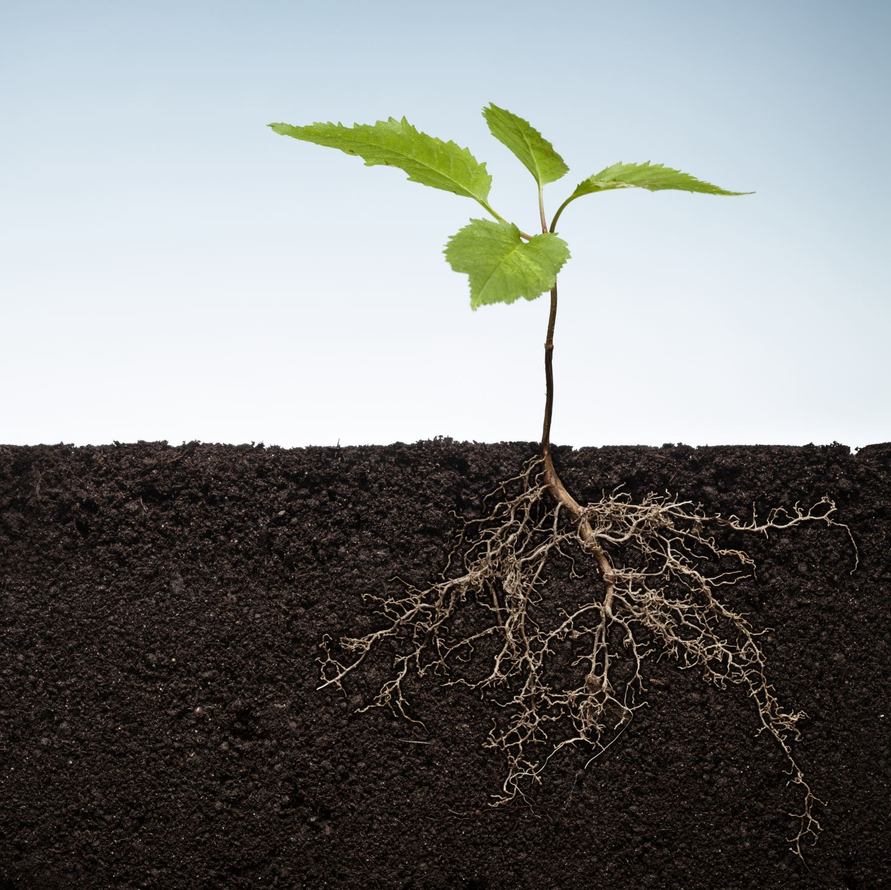
How does your family honour, respect and take care of the land?
Write your answer in a pararaph.

Slide 12
Introduction - Main Idea – introduce the topic – tell what you are going to write about.
My family respects and helps to take care of the land in many ways.
Body - Details – Specifics
We have four places to put our garbage. Food scraps and paper towel, when we need to use it, goes in the compost. Paper, plastics, tin cans and cardboard goes in the blue bin. We save returnable bottles to get the refund, a little extra cash is always fun to have. We put many things that we think we may use for crafts on our craft supply shelf and re-use a lot of garbage this way. The rest of the garbage goes into the garbage can for garbage pick-up but by re-using and re-cycling we limit our waste.
Conclusion - sum up what you said – something for people to remember.
My family helps to take care of the land by re-using and re-cycling our garbage. It is really easy and anyone could do it!

Slide 13
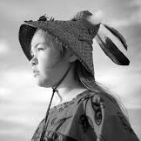
Takaiya-Blaney
Caretakers
Shallow Waters
https://www.youtube.com/watch?v=vRlHjFv0_NQ
Photo - http://www.takaiyablaney.com/
https://www.globalcitizen.org/en/content/global-citizen-of-canada-takaiya-blaney/

Slide 14
Research Assignment
Create Your Own Profile of a Canadian Indigenous Environmentalist
Include:
Name:​
Place of Birth:
Tribal Nation:
Date of Birth: ​
Language spoken:
Brief summary (4-5 sentences, a paragraph) about their activism:
-What specific environmental issue(s) are they concerned with?
- Awards/accomplishments
- Any other interesting notes.

Slide 15
Key Search Words
Chief Dan George
Chief Dan George environmentalist
Chief Dan George
https://en.wikipedia.org/wiki/Chief_Dan_George
https://monova.ca/wp-content/uploads/2019/10/CDNV_DISTRICT_HALL-4101499-v1-Chief_Dan_George_Story_Kit_Update_2019.pdf
http://www.newfederation.org/Native_Leaders/Bios/George.htm
https://www.aptnnews.ca/national-news/a-lament-for-confederation-a-speech-by-chief-dan-george-in-1967/#:~:text=%E2%80%9CA%20Lament%20for%20Confederation%E2%80%9D%20a,Chief%20Dan%20George%20in%201967&text=How%20long%20have%20I%20known%20you%2C%20Oh%20Canada%3F&text=And%20today%2C%20when%20you%20celebrate,my%20meat%20and%20my%20clothing.
https://www.cbc.ca/player/play/937471043585

Slide 16
Writing your paragraph.
Introductory/topic sentence
Who are you writing about?
What Tribal Nation is your person from?
Why are you writing about them?
Details – 1-3 sentences about your topic
What specific environmental issue is this person concerned with?
What has this person accomplished?
Any other interesting information.
What makes this person interesting?
Concluding sentence (May use the word I)

Slide 17
Who?
tribal nation
Why?
Chief Dan George of the Tsleil Waututh Nation was a Canadian Indiginous environmentalist. He believed that his people could learn a lot from people of European decsent and that people of European descent had a lot to learn from Canada's first peoples. He was especially concerned with the impact of pollution on the earth. In 1971 he won The Order of Canada for his work in helping people of European descent better understand indiinous cultures. Chief Dan George got people to start thinking about how they were ruining th environment. I think he was a great inspiation for all peoples.
specific environmental issue
interesting fact / accomplishment
accomplishment
conclusion

Slide 18
Example Paragraph
Farley Mowat
Farley Mowat is a Canadian author and environmentalist. Through his writing he has helped to raise empathy for animals and social issues. As a result of his book "Never Cry Wolf" the Russian government passed a law banning the hunting of wolves. The Sea Sheppard Conservation Society named a ship after him and he received The National Outdoor Book Award along with many other awards for his writing. I agree with David Suzuki, "Farley Mowat is an inspiration.
Why you are writing about this person should made clear in the first sentence.
Use the person's name in the first sentence.
Specific environmentalist issue.
accomplishment
Awards
Concluding personal or "I" statement.

Slide 19
After reading your piece someone should be able to answer the following questions.
Name : ____________________________
Who is the piece about?
__________________________________________________________________________
2. Why did the author (classmate) write about this person?
__________________________________________________________________________
3. What specific environmental issue is this person concerned with?
__________________________________________________________________________
4. What has this person accomplished?
____________________________________________________________________________________________________________________________________________________
5. Has this person won any awards? If so, what were they?
____________________________________________________________________________________________________________________________________________________6. What makes this person interesting or noteworthy?
____________________________________________________________________________________________________________________________________________________

Slide 20
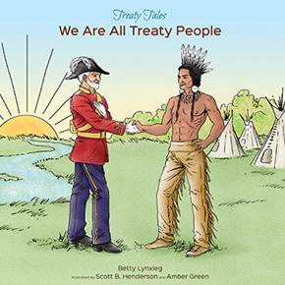
We Are All Treaty Peoples (book) https://www.youtube.com/watch?v=2jb4JesjE1A 25 min
We Are All Treaty Peoples Discussion: What is a simpler term for 'Treaty'? What was agreed upon? Do these impact us today? If so, how?
Indigenous Voices on Treaties
https://www.ontario.ca/page/videos-indigenous-voices-treaties#section-8

Slide 21
5M Treaty
Students will write and lay out their own treaties to be presented for consideration by a member of their family. They can sign if it is agreeable to both parties.
Treaty of Responsibilities between
(A)__Mr. Blake Lynch___
&
(B) Mrs. Janice Innes
Let it be declared that Blake Lynch agrees to:
take out the garbage and recycling,
wash any dish/pot not dishwasher safe,
and clean the toilets/shower in the upstairs bathroom.
In exchange for fulfilling such responsibilities Janice Innes agrees to;
take care of any food related gross things resulting from food spoilage or leftovers being forgotten and pushed to the back the fridge.
This includes taking the expired/spoiled food to the compost bin outside.
On this day, January 13, 2021 both parties entered into this agreement under their own free will and volition and were not coerced to do so.
(A)_____________________________ (B)____________________________

Slide 22
Example Treaty
Playstation 5 Treaty ​ between​
(Student name)
&​
(family member's name)
​
Let it be declared that I, (Student name), agree to fulfill the following in exchange for an extra half-hour of access to the Playstation 5 gaming system per day.
I will clean my room.
I will take the dog for a walk and ensure it has food and water.
I will complete my homework immediately when I get home.
Get all 3's or above on report cards ________________________________ _______________________________

Slide 23
More Important Words
Crown-
Reserve-
Metis-
Inuit-
Scrip-
Natural resources-
Reconciliation-

Slide 24
Crown- ​refers to the British monarchy, provincial or federal government
Reserve-​ a place set aside for special use, in this case territory for an indigenous community
Metis-​ a person with mixed indigenous and European ancestry
Inuit-​ an indigenous person from Northern Canada Scrip-​ a certificate entitling the holder to acquire possession of certain portions of public land
Natural resources-​ materials or substances such as minerals, forests, water, and fertile land that occur in nature and can be used for economic gain
Reconciliation-​ the restoration of friendly relations – the act of asking for and receiving foriveness
​

Slide 25
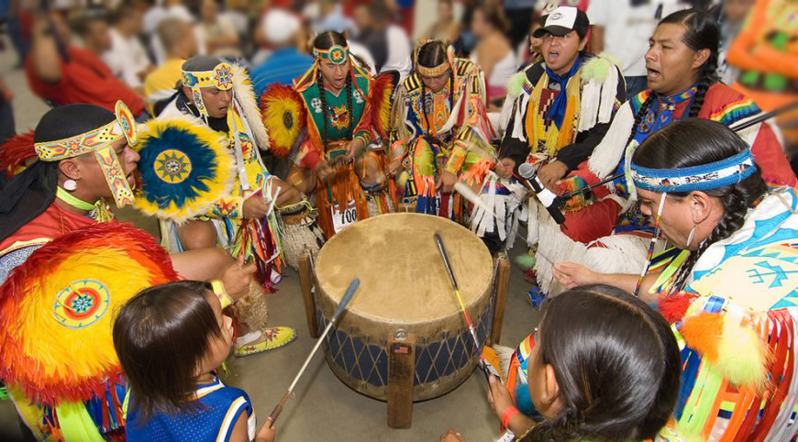
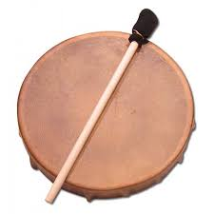
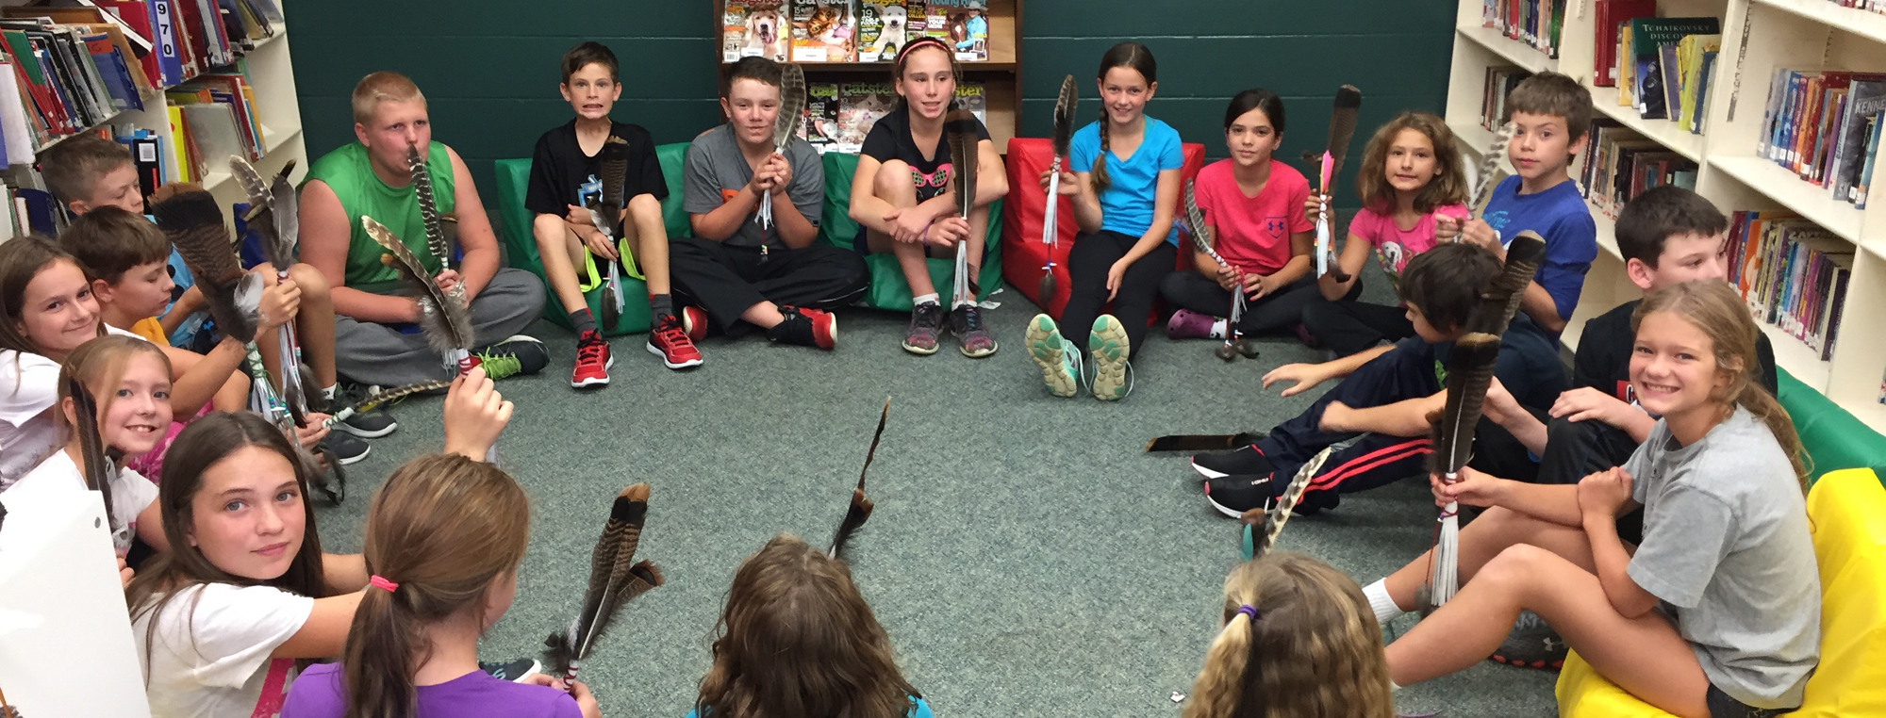

Slide 26
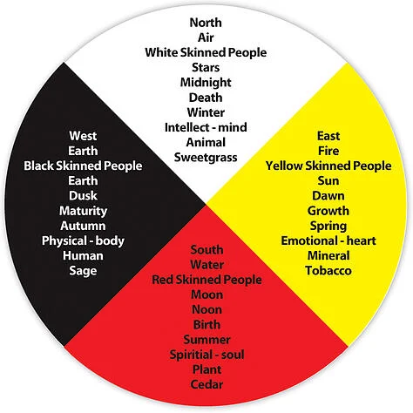

Slide 27
1. Worldview
2. Culture
3. traditional knowledge
4. stewardship 5. Sustainable 6. Principle 7. Well-being

Slide 28
Worldview- ones' conception or understanding of the world in which their comprehension is especially derived from a specific standpoint
Culture- shared customary beliefs, social forms, and material traits of a racial, religious, or social group
Traditional knowledge – information acquired from past practices or conventions handed down from age to age
Stewardship- the careful and responsible management of something entrusted to one's care

Slide 29
Sustainable -
Principle- fundamental truth or proposition that serves as the foundation for a system of belief or behavior or for a chain of reasoning. well-being - being comfortable, healthy, or happy with respect to one's own physical, mental, emotional and spiritual states

