Slide 1
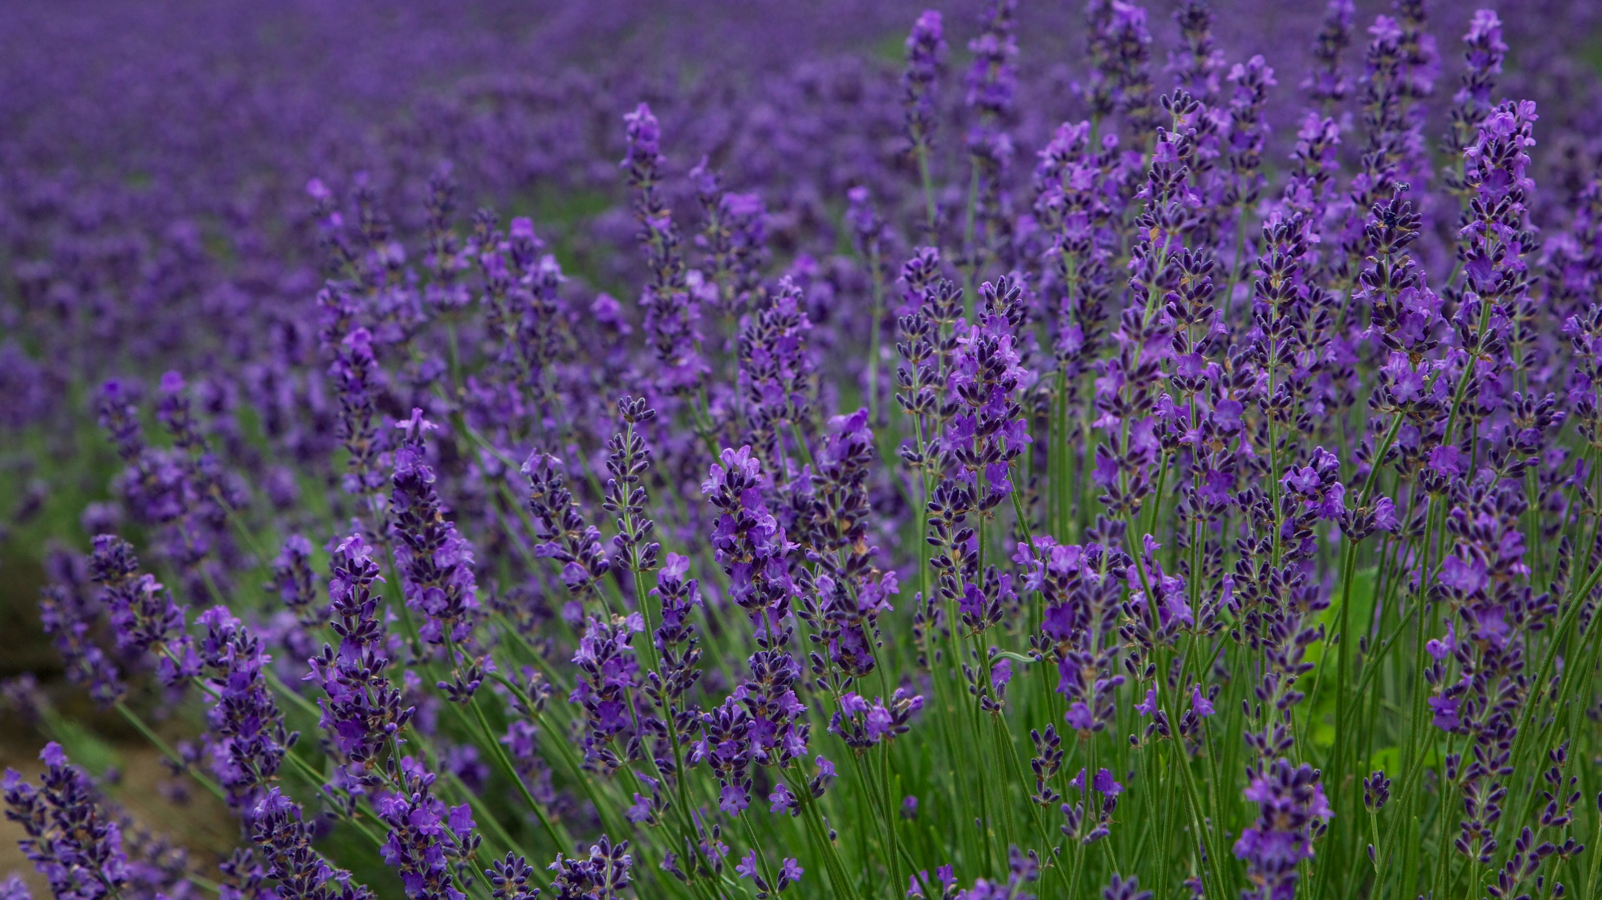
February
Morning Warm-Ups
This Photo by Unknown author is licensed under CC BY-SA.

Slide 2
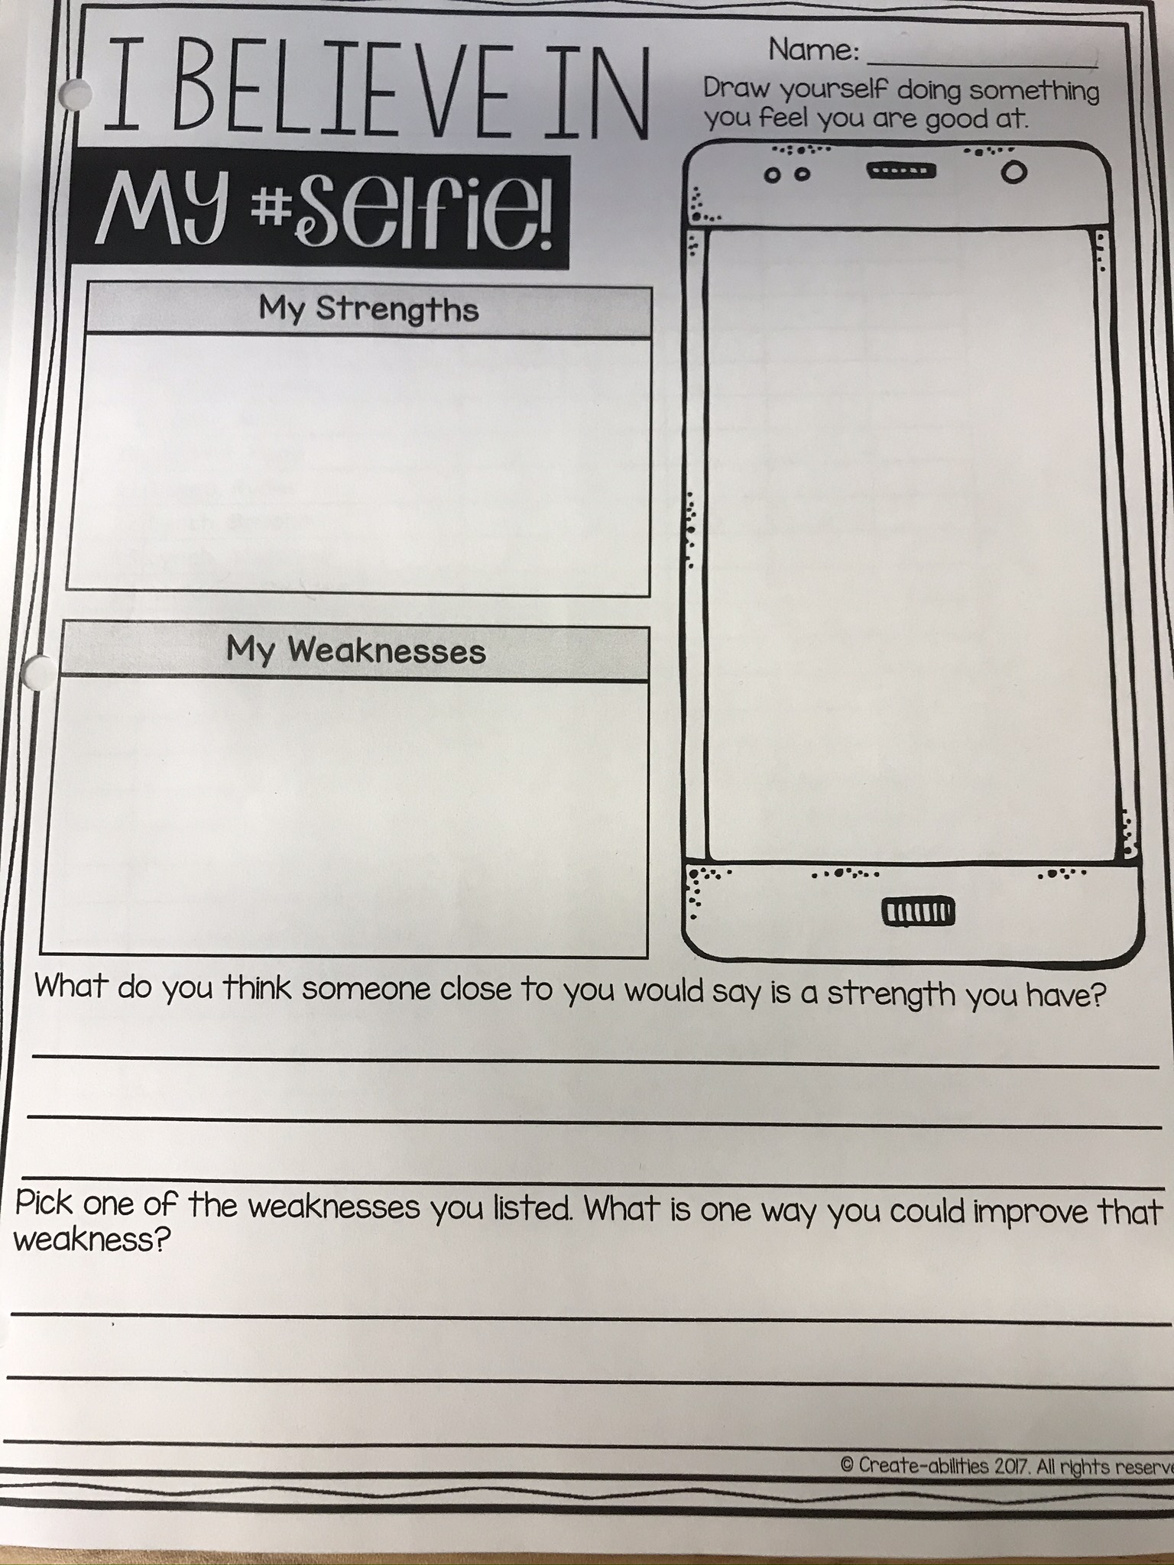
We all have strengths and weaknesses and acknowledging them makes us more self-aware.
As a class we can help each other and seek help from others when we know the strengths and weaknesses of others.
List
3-4 things
List
3-4 things
Complete sentence.
Answer must be in sentence form.

Slide 3
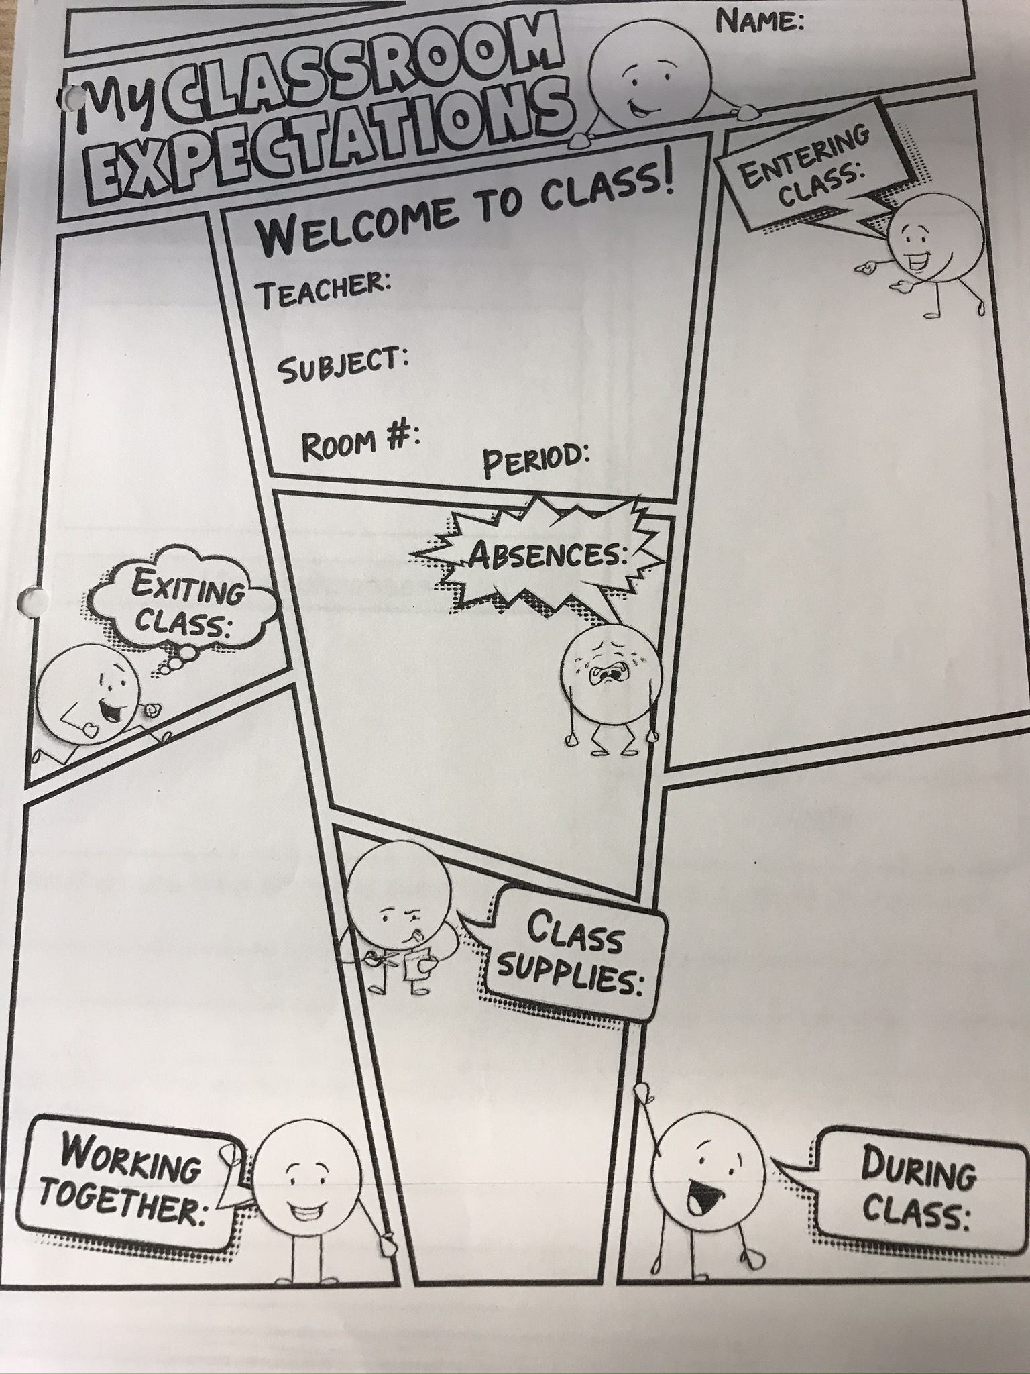
Quick Review
What do you remember?
Fill this sheet out with all Language Arts and cross-curricular subjects in mind.

Slide 4
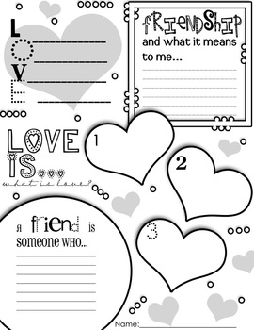
Don't forget to change your "Raven Tales" book!
Fill in the blanks
Use single
words or
sentences.

Slide 5
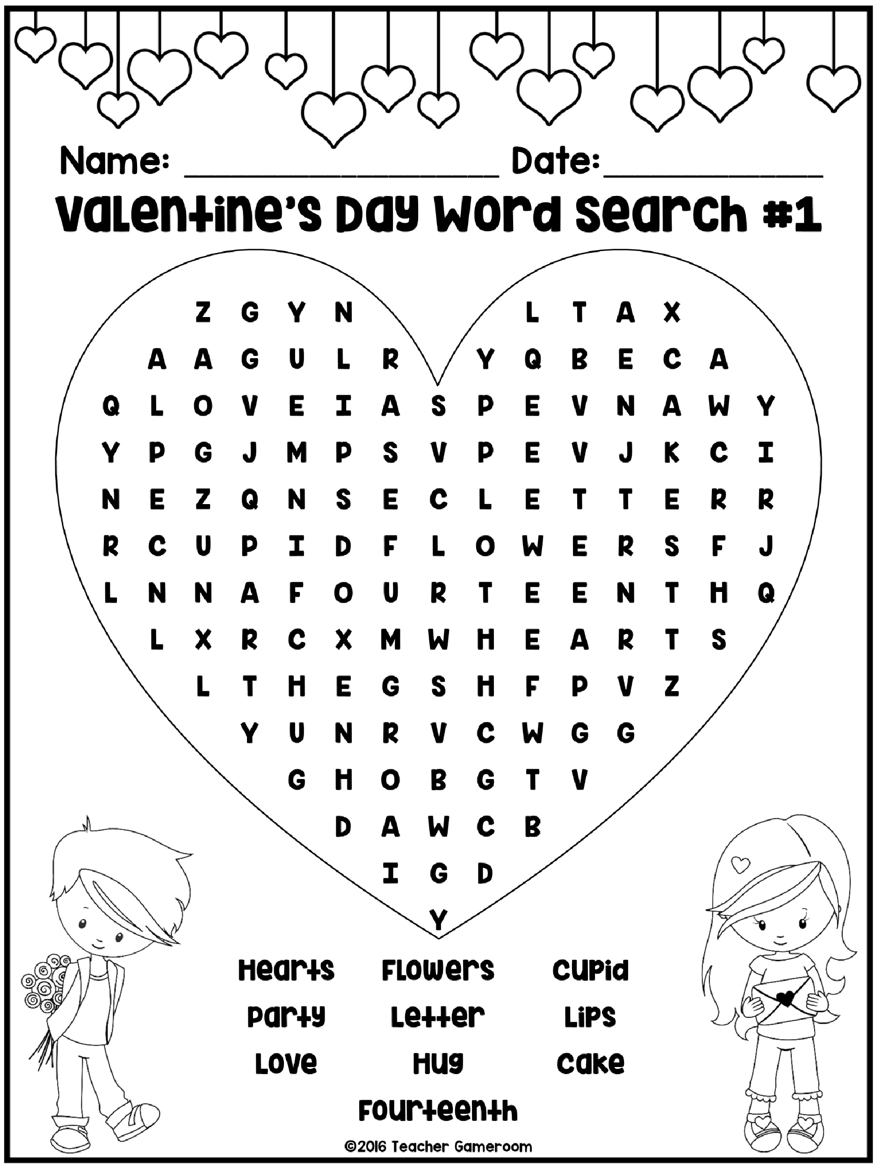
1. Pick a word search worksheet from the bin.
2. Pick 3 words from the list and tell what they have to do with valentine's day.
3. Your explanations need to be written in sentence form.

Slide 6
friendly
Colour the hearts that describe you. Fill in the blank hearts with other words that describe you.
energetic
empathetic
Cool
smart

Slide 8
plane
sun
through
stares
for
male
read
daze
flower
fir
Write 5 sentences using some of the words you didn't use on the homonym worksheet yesterday.

Slide 9
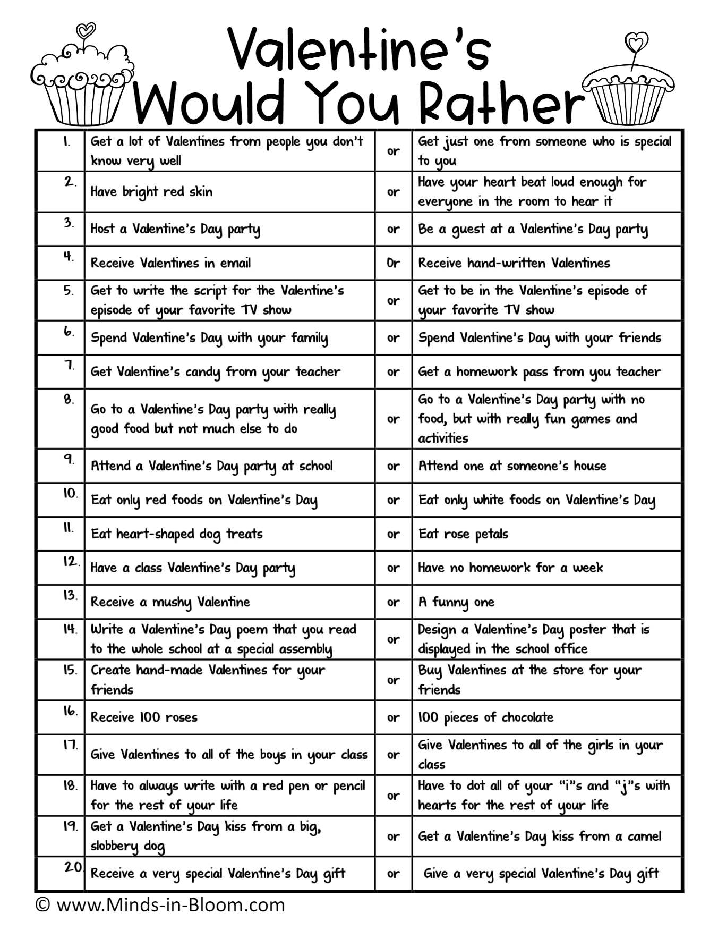
Pick one "Would You Rather" choice and explain why you chose the way you did. This should be written in paragraph form. See my example on the flip chart paper.

