Slide 1
Reading Log

Slide 2
The Misfits
Pages 1-10
#1 Heart – to - Heart
Main Character – Bobby
Conflict – Bobby's friends want to hang out with him but he must work.
The word "I" is always written in upper case. I'm is an abbreviated form of I am so is also always capitalized too.
Bobby, I think you handled the situation with your friends well. You showed a lot of responsibility by telling Skeezie you couldn't leave work to go to meet them at the Candy Kitchen. You should be proud of yourself. encourage

Slide 3
The Misfits
Pages 11-21
In today's reading Ms. Wyman seems to get angry quite a bit. She raises her voice at Kevin and she furrows her brow at Addie. Ms. Wyman was having a hard morning.
#2
Mood Clues
This Photo by Unknown author is licensed under CC BY-SA.
This Photo by Unknown author is licensed under CC BY-SA.
This Photo by Unknown author is licensed under CC BY-NC.
This Photo by Unknown author is licensed under CC BY-NC-ND.

Slide 4
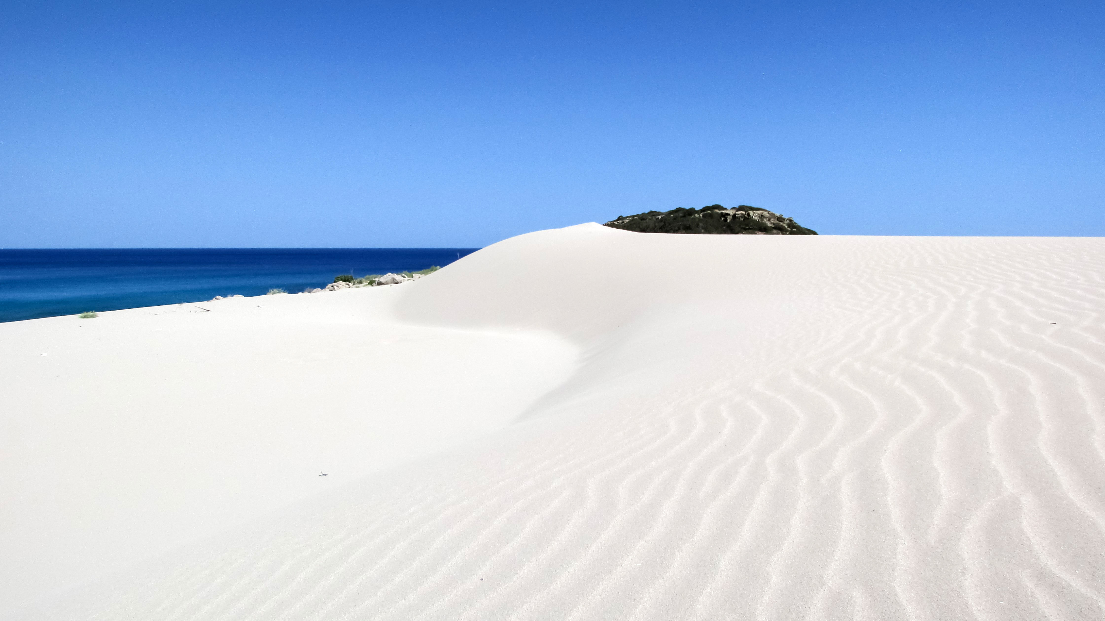
#3 Deserted Island
Note
This response should be 2 paragraphs long.
The Misfits
Pgs 22 - 30
If I were stuck on a deserted island, I would like to have Bobby with me. Bobby is very nice and I think we would be able to get along. Bobby also reads a lot and he may have picked up some good survival techniques from his reading. I think Bobby and I would be able to survive together on a deserted island.
I would most definitly not want to be stuck with Addie. She would probably be very bossy and make me do all the work. I think we would spend too much time fighting and arguing.

Slide 5
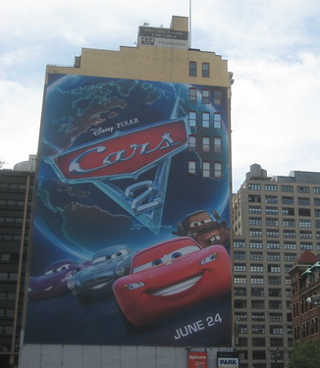
#4 - Movie Tag Line
Here is an actual movie tag line example.
Ahhh... it's got that new movie smell. Our Cars Speak For Themselves. Life is a journey.
The Misfits
Pages 31 – 38
Join the group of five as they address the issue of name calling during those tough adolecsent years.
This Photo by Unknown author is licensed under CC BY-NC-ND.

Slide 6
#5 Show Me The Support
The Misfits
P 39 - 49
Support
Pg 42
"I look at the clock. I have been working (or what passes for working at Awkworth & Ames) for only forty minutes. I am not entitled to a break until I have worked for at least an hour. It says that somewhere in the six stapled pages.
"Not yet," I tell him."
This passage demonstrataes that Bobby is responsible because even when no one is looking he doesn't take a break before he should.
Bobby
Adjectives
kind
considerate
friendly
caring
concerned
honest
responsible

Slide 7
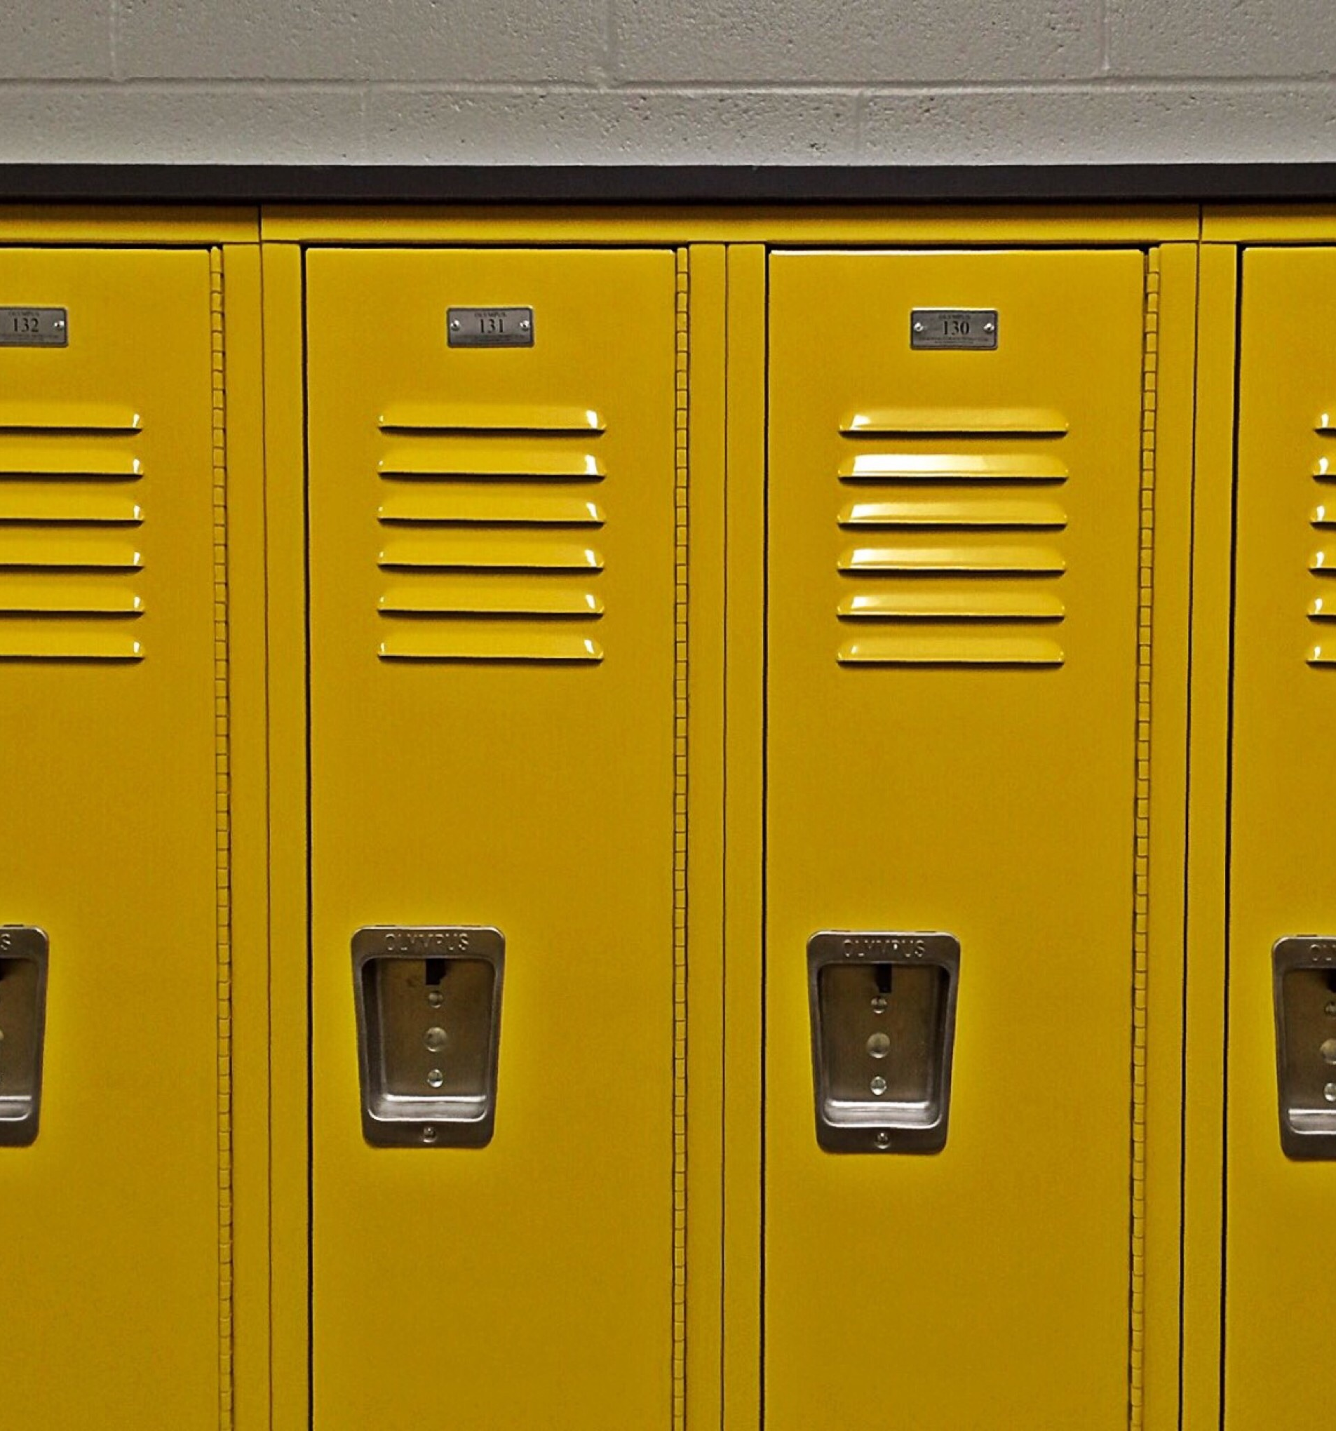
# 6 - Kevin
"Joe is such a lady. I can't believe he let someone get away with that. I would have punched someone in the face. You can't let people get away with this stuff."
The Misfits
Pgs 50 - 56

Slide 8
Unsolvable!
The Misfits
Pgs 56 - 63
Bobby's family is having financial problems since his mother passed away with cancer. Bobby has a part time job which helps his dad out a bit. Family money problems are not a child's responsibility. This would be a problem that Bobby would have little control over so he cannot solve it.
This Photo by Unknown author is licensed under CC BY-NC.
We should try to start sentences differently and avoid using the same word to start 2 consecutives sentences. In this case however we are not referring to Bobby both times, so it is acceptable.
Cannot is more forceful than can't and should be used when you are trying to make your point.

Slide 9
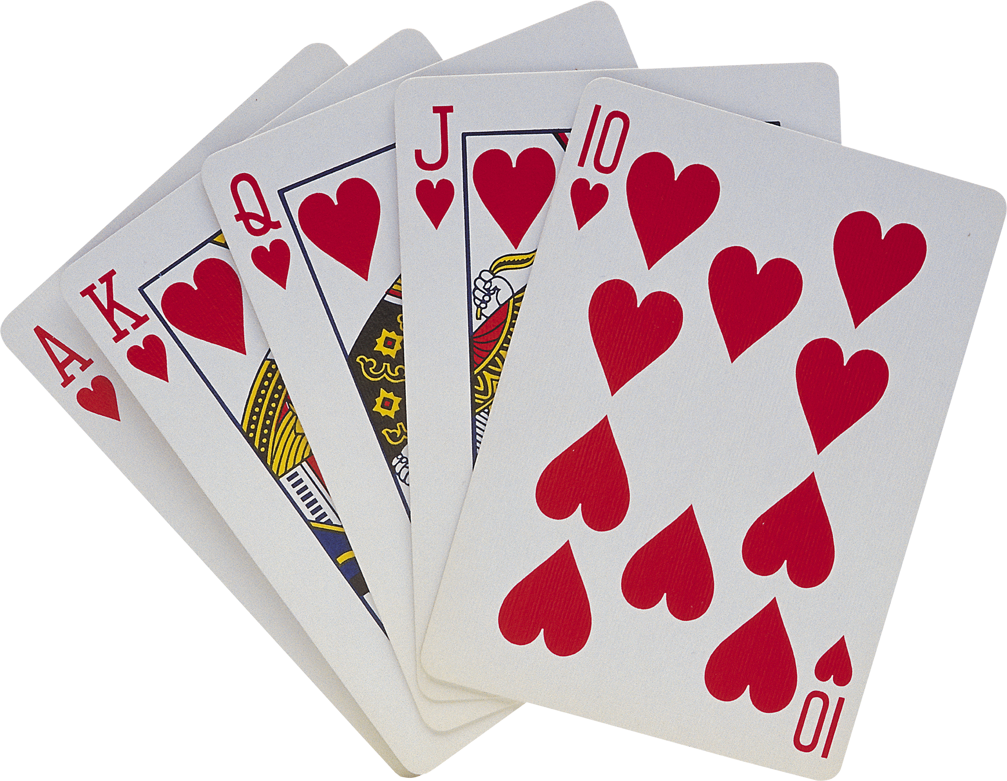
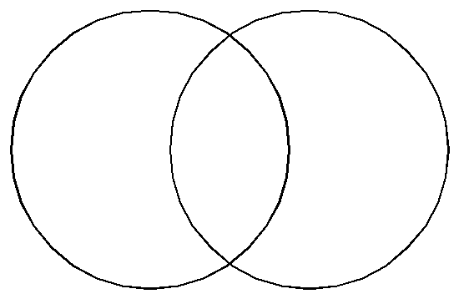
The Misfits
Ps 64 - 75
#8 Favorite Things
This Photo by Unknown author is licensed under CC BY-NC.
This entry requires a two-part answer. Each part should have its own paragraph. See the next slide for an example answer.
Bobby
Old movies
Me
historical movies
Work
Gardening flowers
Family
Friends
Cards
eating
This Photo by Unknown author is licensed under CC BY-NC-ND.

Slide 10
#8 Favorite Things (continued)
Sentences should not start with also, instead of saying Also bobby..... , say Bobby also …..
Bobby values family and friends, old movies, playing cards and food. Throughout the book he keeps telling us what old time theme song would fit with what is happening at the time. He spends a lot of time with his dad watching old movies and playing cards, they often finish their evening eating ore cookies and drinking milk. Bobby loves peanut butter and fluff sandwiches and has the nickname fluff. Bobby also spends a lot of time with his friends and one of their regular meeting places is a little dinner called The Candy Kitchen.
Boby and I actually have a lot in common. Family is the most important thing in my life. I enjoy watching movies and playing games with my children and grandchildren. One of my other passions is food and I have a sweet tooth just like Bobby. I think we would make great friends with all our common interests.

Slide 11
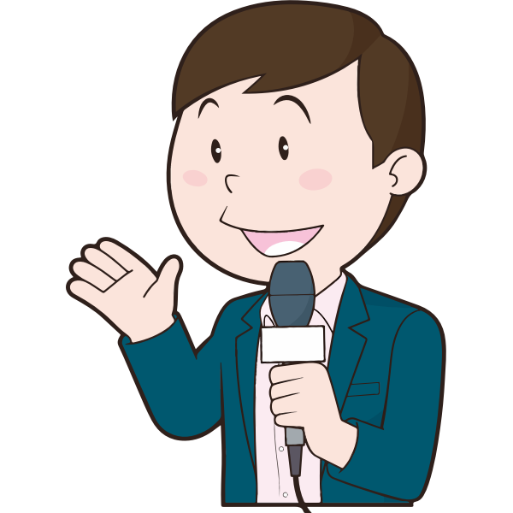
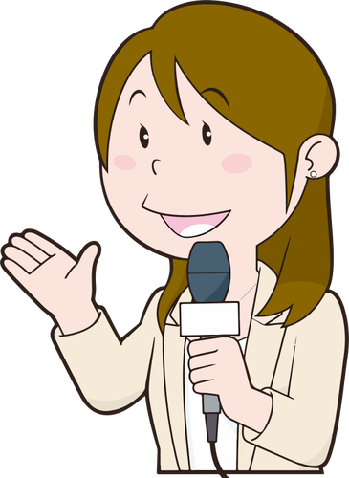
The Misfits
Pgs 76 - 87
# 9 - What's Up?
A few topics I could speak to a reporter about could be name calling and the local election for city council. They are also having school elections in the book. This is how my life connects to the book.

Slide 12
# 10 - Make it a Bestseller
The Misfits​
Pgs 88 - 94
Another possible title for this book could be Make a Difference. The main characters are trying to make a difference in their school by participating in school politics. People want to make a difference in life so I think this title would work.
This Photo by Unknown author is licensed under CC BY-SA-NC.

Slide 13
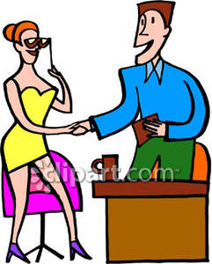
Talk-Show Question
The Misfits​
Pgs 95 -104
When I think of Bobby, I would have to say that people are good hearted. In Bobby's word's he characterises himself as "a get-along kind of guy". He was nice to Mr. Kellerman's replacement even when he didn't really like him, he moved over to give DuShauwn a seat and he played along with Mr. Kellerman's matching game to please him. Bobby is just an all-round good guy.
This Photo by Unknown author is licensed under CC BY-NC-ND.

Slide 14
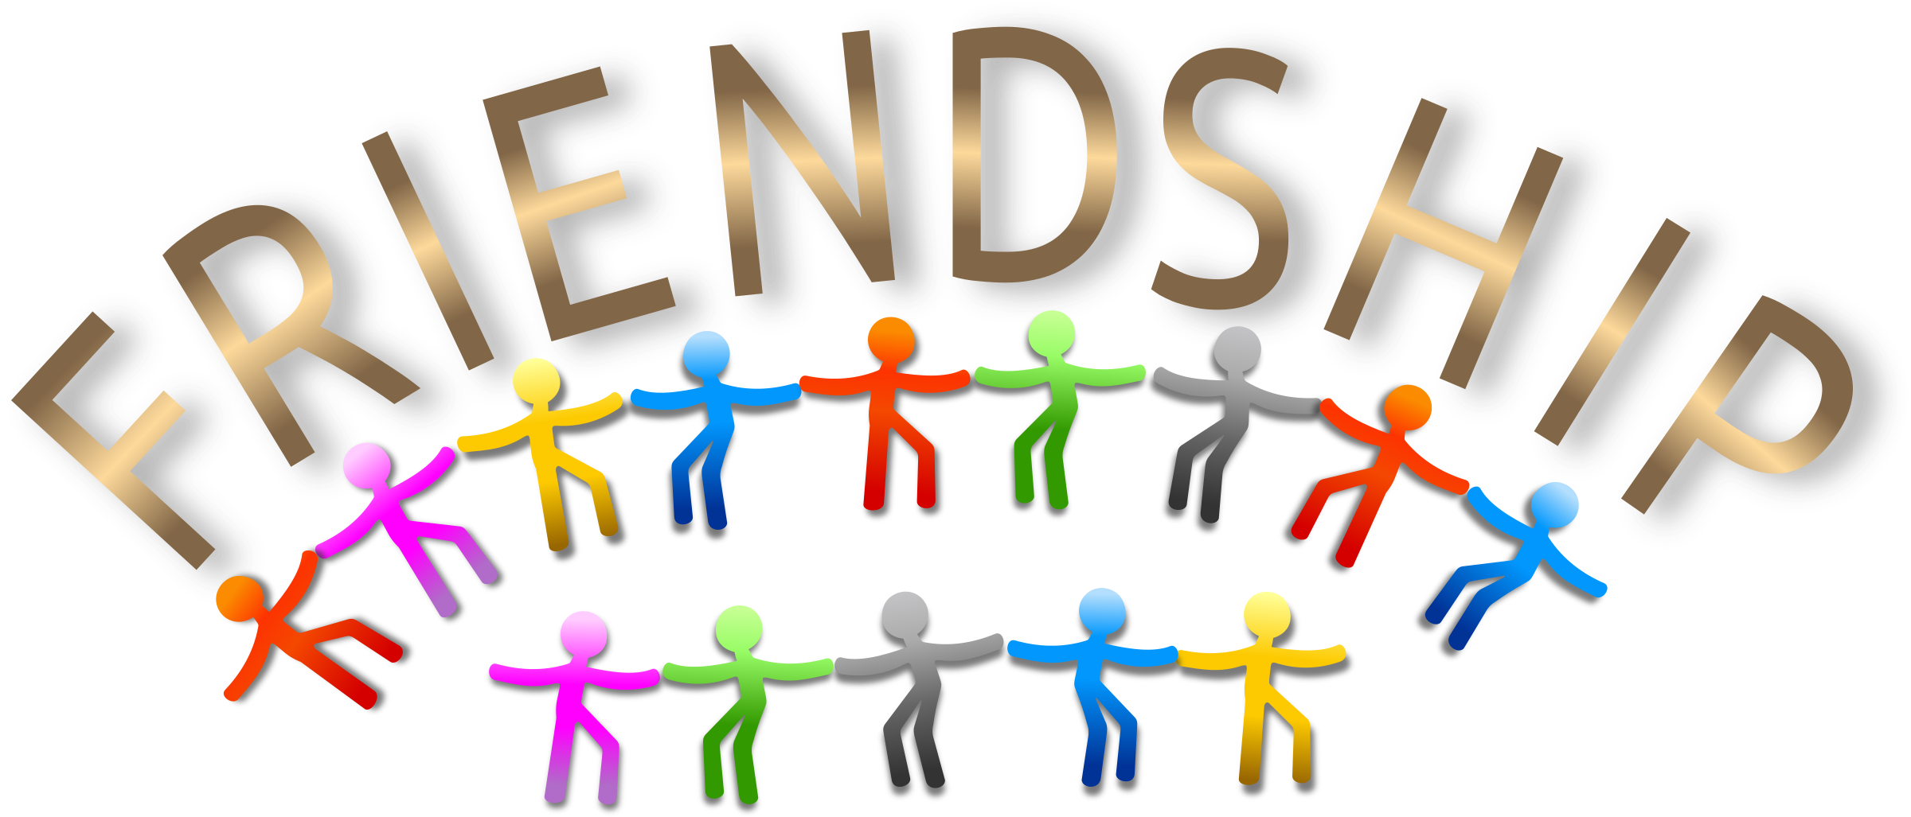
The Misfits​
Pgs 105 - 124
# 12 - Pick a Theme
introductory sentence
answer to the question
This book addresses a lot of themes. Friendship is a major theme in this chapter. Joe tells his friends something he has never told anyone else. His friends support and except him as he is. This scene shows what real friendship is all about.
support from the chapter
concluding sentence

Slide 15
# 13 – Past, Present, Future
The Misfits
Pgs 136 -
This book was written 20 years ago in 2001.

Slide 16
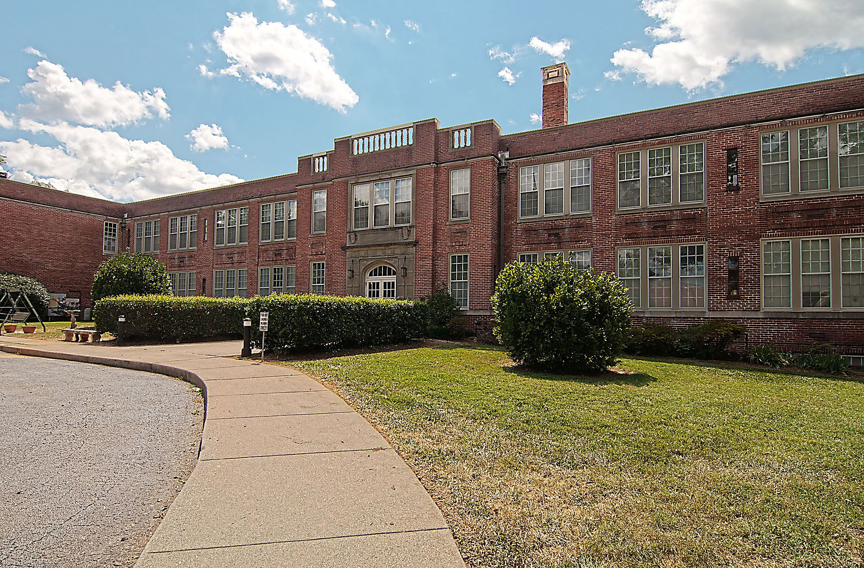
The Misfits
Pgs 125 - 135
#14 – Important Scenes
School has a huge impact on my character's life. Most of the story takes place in the school. At school Bobby gets called Fluff, Blubber and other names. Bobby feels hurt when he is called these names, he says "It doesn't matter how many times I've been called names, it still hurts".
This Photo by Unknown author is licensed under CC BY-SA.

Slide 17
The Misfits
Pgs
# 15 – Clues About Time

Slide 18
#16 – You Are There
The Misfits
Pgs

Slide 19
https://www.grammar-monster.com/easily_confused/which_witch.htm

