Slide 1
Community-Centered Values
Me & My World

Slide 2
Copy
Right Matters
If you add pictures or anything else from the internet to your PowerPoint presentation it is important to site where you got it.
https://www.yumpu.com/en/document/view/22714561/copyright-matters-st-clair-cds-board

Slide 3
Please use proper mechanics of English writing, grammar and the 6+1 traits when writing. Your work will be marked accordingly.

Slide 4
Define Community.

Slide 5
List at least 5 communities that you belong to.
A list requires a title and bullets.
Communities I Belong to
School

Slide 6
Define moral values.

Slide 7
Make a list of at least 10 moral values that you believe are important to have.

Slide 8
Pick a value from your list and find a quote that says something about it.
Don't forget to site your quote ~ who is originally credited for saying it.

Slide 9
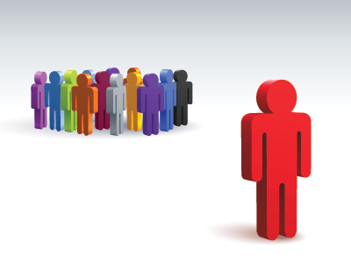
Define "clique"
This Photo by Unknown author is licensed under CC BY-NC-ND.

Slide 10
***Remember a list requires a title and bullets.***
Make a list of the cliques that exist in your school.

Slide 11
Define Discrimination.

Slide 12
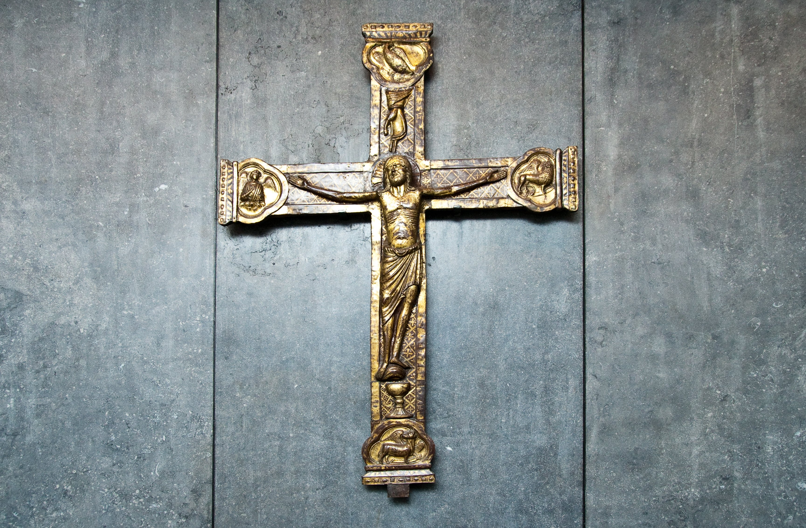
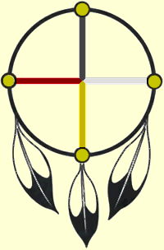
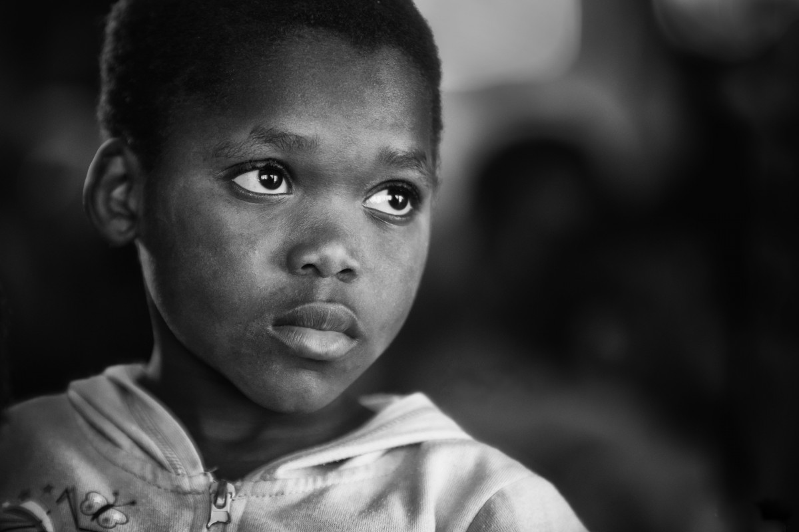
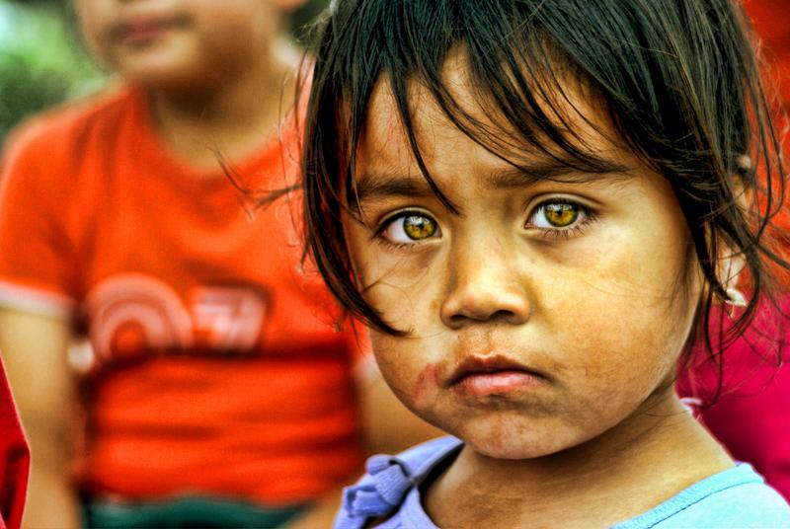
Make a list of at least five different groups of peoples who have faced discrimination in history.
This Photo by Unknown author is licensed under CC BY-SA.
This Photo by Unknown author is licensed under CC BY-SA-NC.
This Photo by Unknown author is licensed under CC BY-SA.
This Photo by Unknown author is licensed under CC BY-SA.
This Photo by Unknown author is licensed under CC BY-NC.
This Photo by Unknown author is licensed under CC BY-SA-NC.

Slide 13
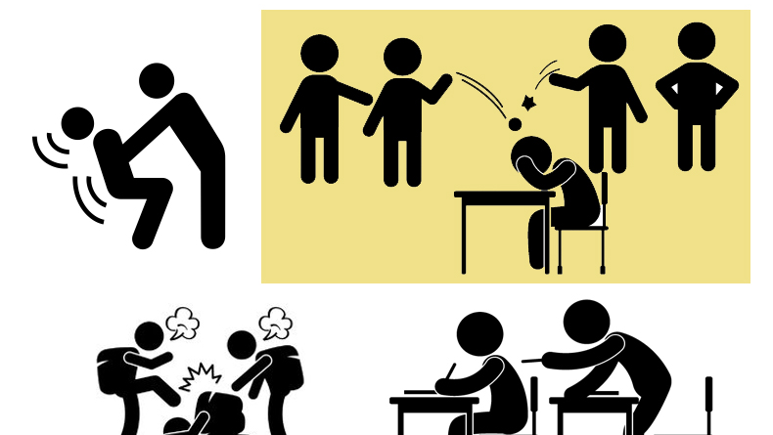
Define bully, victim and bystander.
This Photo by Unknown author is licensed under CC BY-SA-NC.

Slide 14
Create a slide depicting the difference between bullying and conflict.

